Slide 1
UFlorida iGEM 2021
Mitigating Antibiotic Resistance
Notes:
Hello everyone and thank you for taking the time to listen to our presentation! We are UF’s iGEM team, which we’ll be telling you all about in our presentation. We expect this to take between 45 and 50 minutes to give you guys time to ask questions at the end!

Slide 2
01
Introduction
TABLE OF CONTENTS
02
Our Project Part 1
03
Our Project Part 2
04
How you can get involved!
What is iGEM? Who are we?
Our goals, background information and relevant context
The Science Stuff!
You can contribute to our project!
Notes:
This is going to be the outline of our presentation today. We’re going to start by introducing iGEM to you, followed by giving you all a brief introduction to us, the team. Then, we’re going to introduce our project to you all, which is related to fighting pathogens using novel mechanisms to fight antibiotic resistance. We’ll begin by giving you all the context to our project, relevant context to the premise of our project, and then introduce our goals. Then, we will go over the actual science stuff in the project, where we hope you may learn something new! Lastly, we’ll finish off by sharing an opportunity with you where you can get involved to help contribute to our project and possibly receive some perks of your own by doing this.

Slide 3


01 Introduction
What is iGem?
Who are we?
Notes:
So, for our introduction, I’m going to be telling you a bit about what iGem is and who we, the team are!

Slide 4
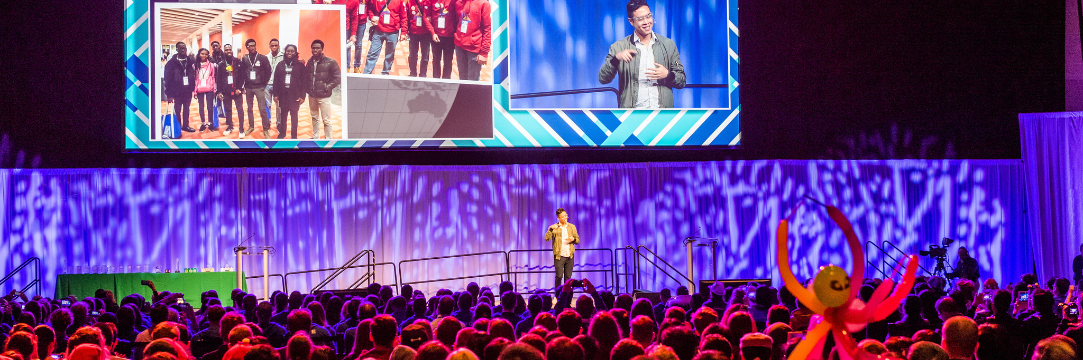
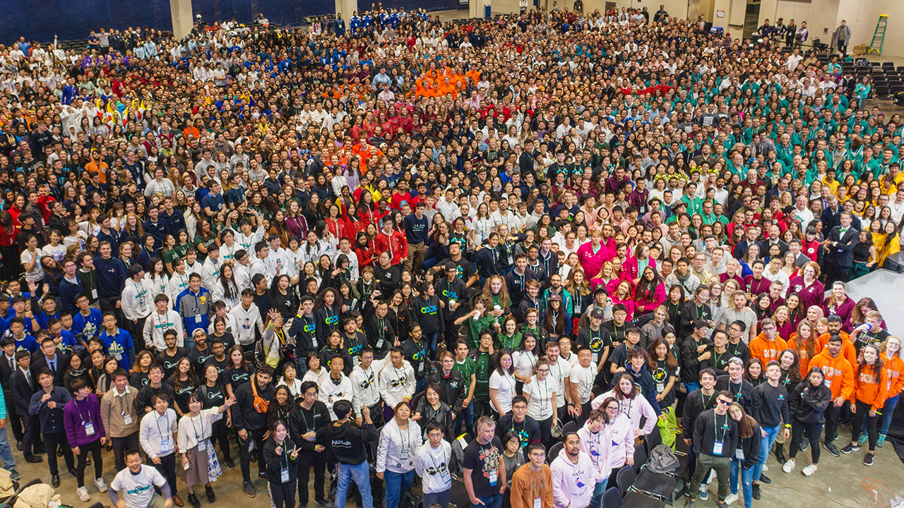
What is iGEM?
iGEM stands for Internationally Genetically Engineered Machine
Notes:
So, by now you all must be wondering, what the heck is iGem? [click]
The International Genetically Engineered Machine (iGEM) Foundation is an independent, non-profit organization dedicated to the advancement of synthetic biology, education and competition, and the development of an open community and collaboration. This is done by fostering an open, cooperative community, and friendly competition.
iGEM’s biggest program is the iGEM Competition[click]. The iGEM Competition gives students the opportunity to push the boundaries of synthetic biology by tackling everyday issues facing the world. Made up of primarily university students, multidisciplinary teams work together to design, build, test, and measure a system of their own design using interchangeable biological parts and standard molecular biology techniques. Every year nearly 6,000 people [click] dedicate their summer to iGEM and then come together in the fall to present their work and compete at the annual Jamboree.

Slide 5
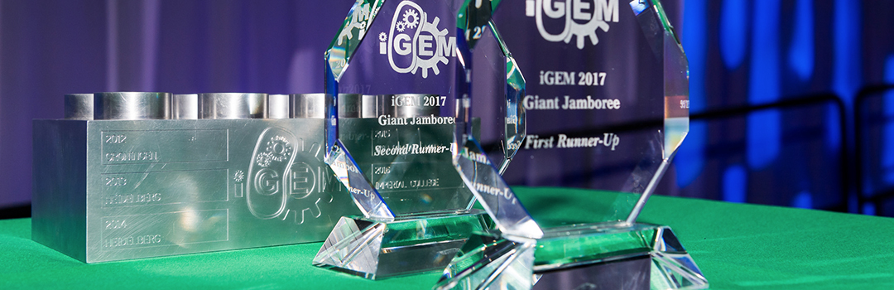








PRIZES!
Grand prizes!
Best Diagnostics Project
Best Information Processing Project
Best Foundational Advance Project
Best Energy Project
Best Hardware Project
Best Environment Project
Best Food & Nutrition Project
Best Manufacturing Project
Notes:
At this jamboree, also known as the competition, the teams compete to win a vast array of prizes.
You can win grand prizes [click], which are given to the best of the best!
There are also track awards, which are given to:
Best diagnostics project [click]
Best energy project [click]
Best environment project [click]
Best food and nutrition project [click]
Best foundational advance project [click]
Best hardware project [click
Best information processing project [click]
Best manufacturing project [click
And so much more!
This is all to highlight that the possibilities at iGEM are endless, and if your are interested in absolutely any aspect of science there is room for you to explore it as a project and compete with it at the iGEM competition

Slide 6
So… what is an iGEM team?
WET LAB
DRY LAB
There are multiple components!
HUMAN PRACTICES
WIKI
Notes:
IN order to compete in the iGEM competition you need to have a team.
And, each iGEM project has multiple components. (click)
These components are:
Wet lab (click)
Dry lab (click)
Human Practices (click)
And the Wiki division (click)

Slide 7
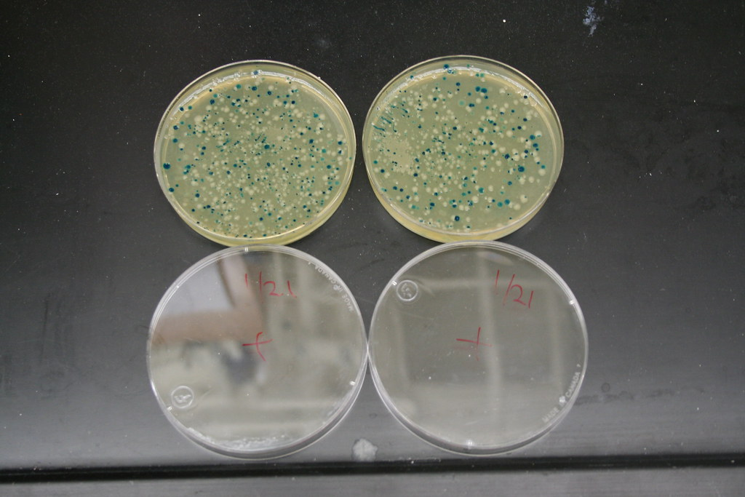
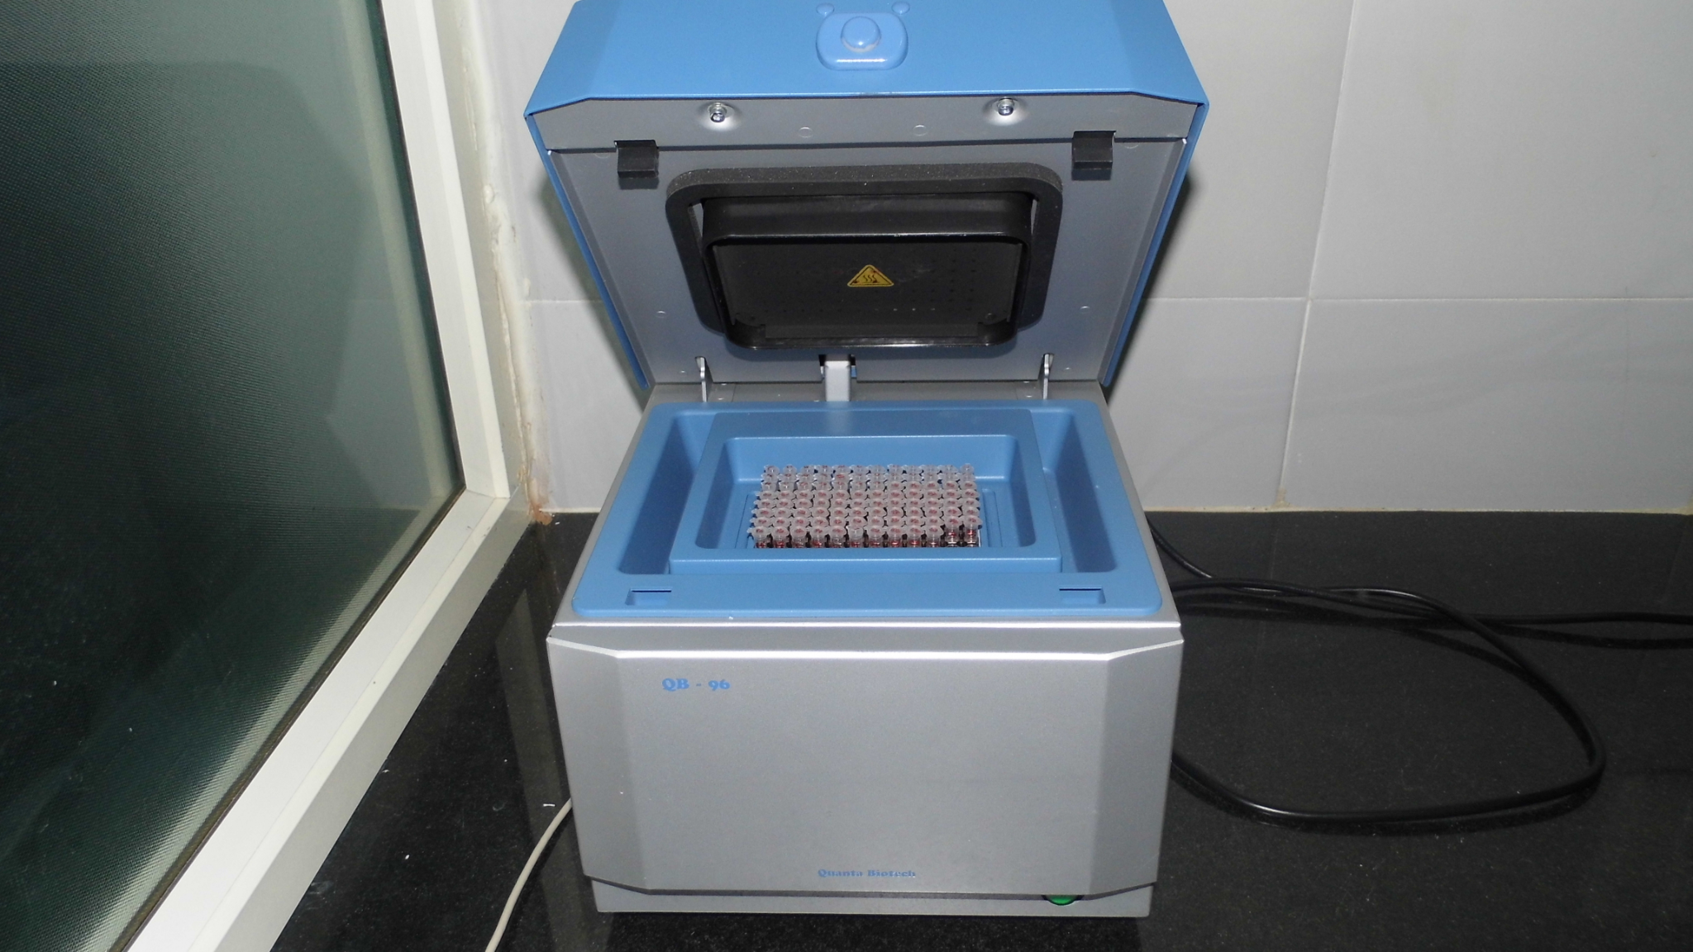
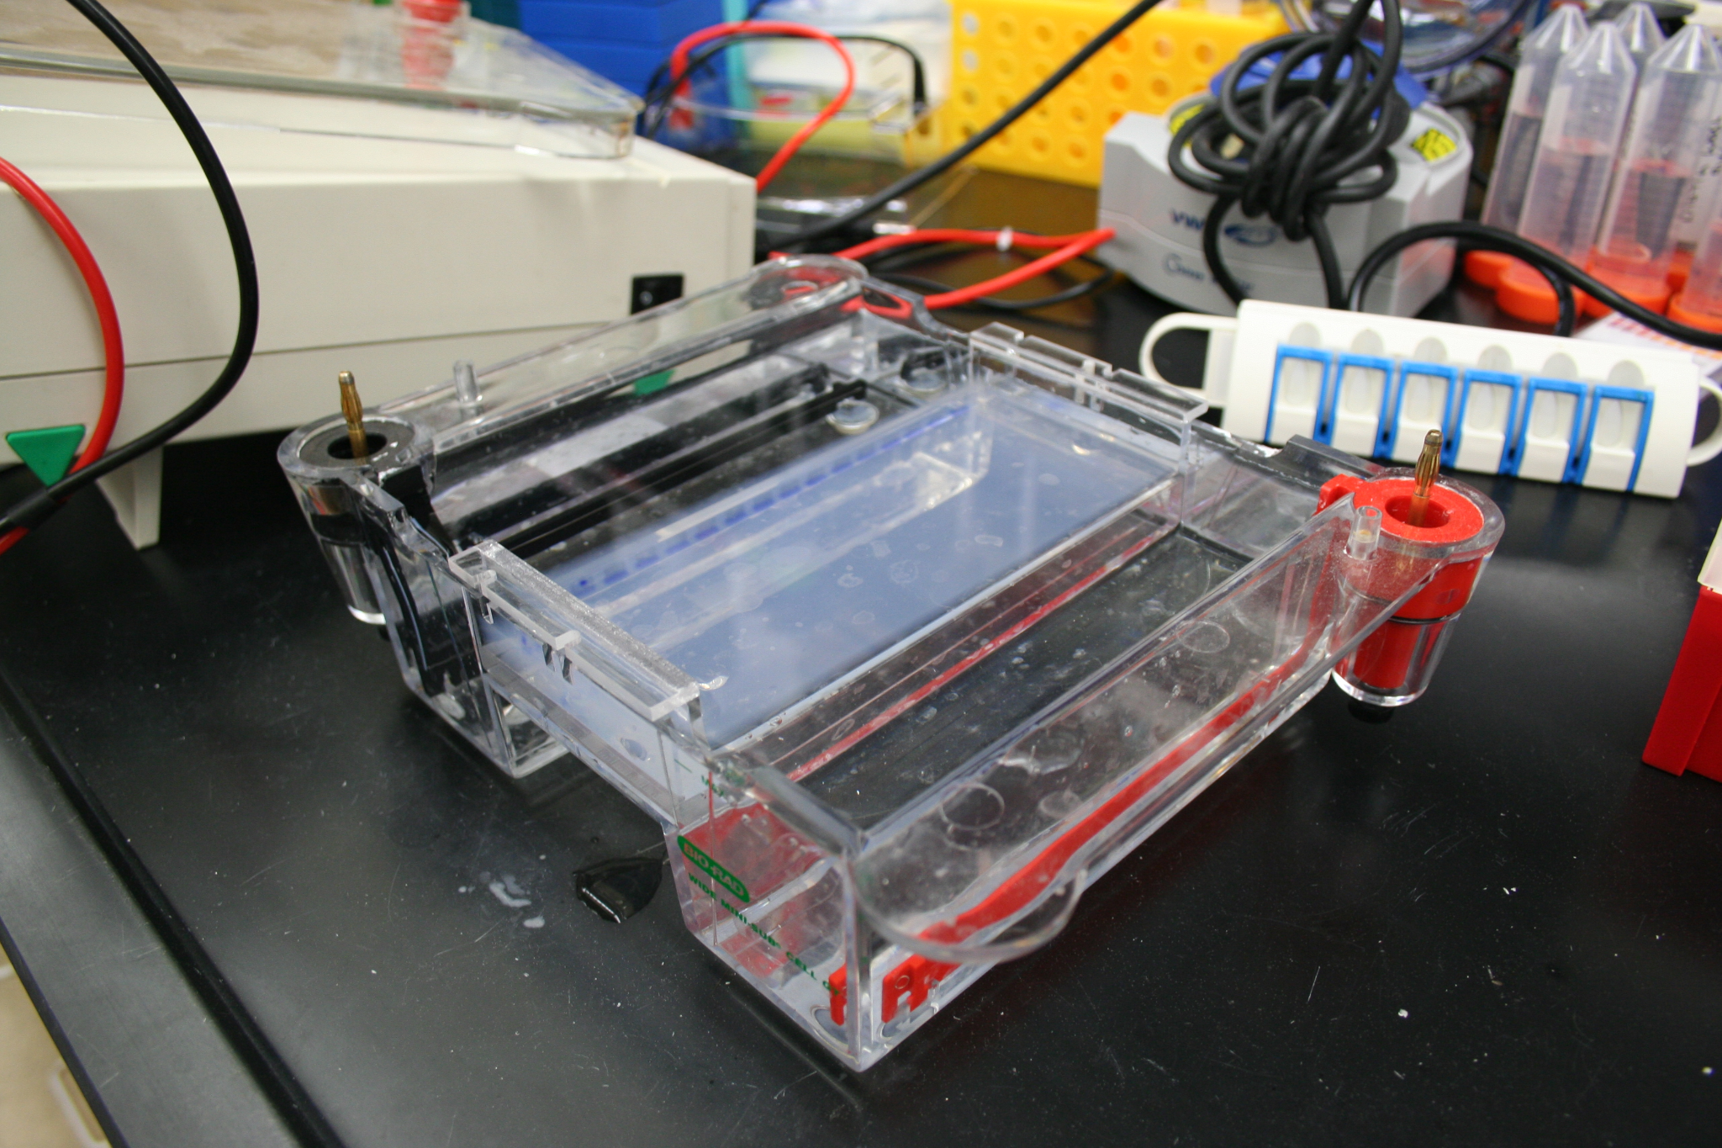
WET LAB
Notes:
Wet lab is in charge of the actual project. They work with bacteria, plasmids, anything in the traditional lab setting that you would think of. Here we have pictures of some cultures, a PCR machine, and gel electrophoresis. We’ll go more into depth about what those are further down in the presentation.
Bacteria source: https://www.google.com/url?sa=i&url=https%3A%2F%2Fwww.flickr.com%2Fphotos%2F34857812%40N04%2F3256354319&psig=AOvVaw0VIzJiXQrUyjqjIm4xIoNC&ust=1626806111399000&source=images&cd=vfe&ved=0CAsQjRxqFwoTCPCO-5fj7_ECFQAAAAAdAAAAABAO
PCR source:
https://upload.wikimedia.org/wikipedia/commons/f/ff/96_well_PCR_thermocycler.JPG
Gel source:
https://upload.wikimedia.org/wikipedia/commons/8/86/Large_Gel_Electrophoresis_Chamber_with_Agarose_gel_inside_-_%283%29.jpg

Slide 8


DRY LAB
Notes:
Dry lab works more with the conceptual aspects of the project. They are currently using math to predict the behavior and performance of our genetic circuits. Currently we're in the process of designing and coding up the equations we need to use to do that prediction. Last year they used Matlab, which they found an intensive and tedious process (you’ll know if you’ve ever used Matlab), but this year they are using Python.

Slide 9
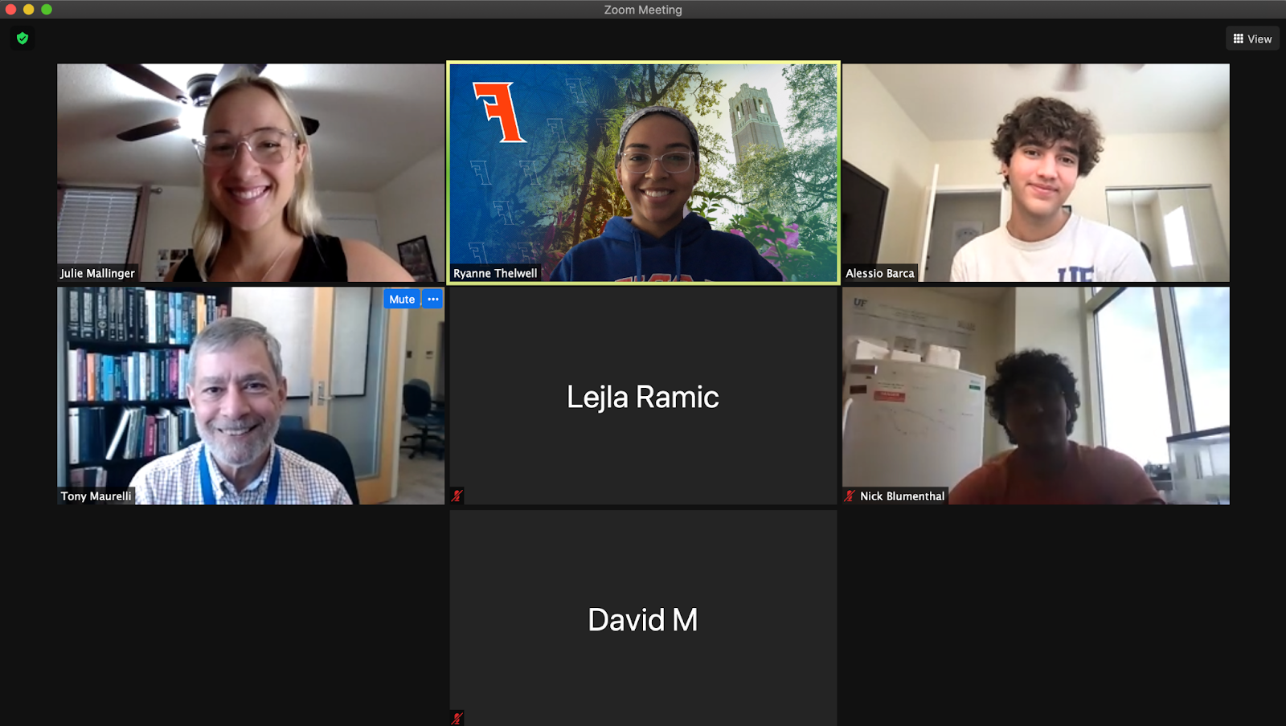
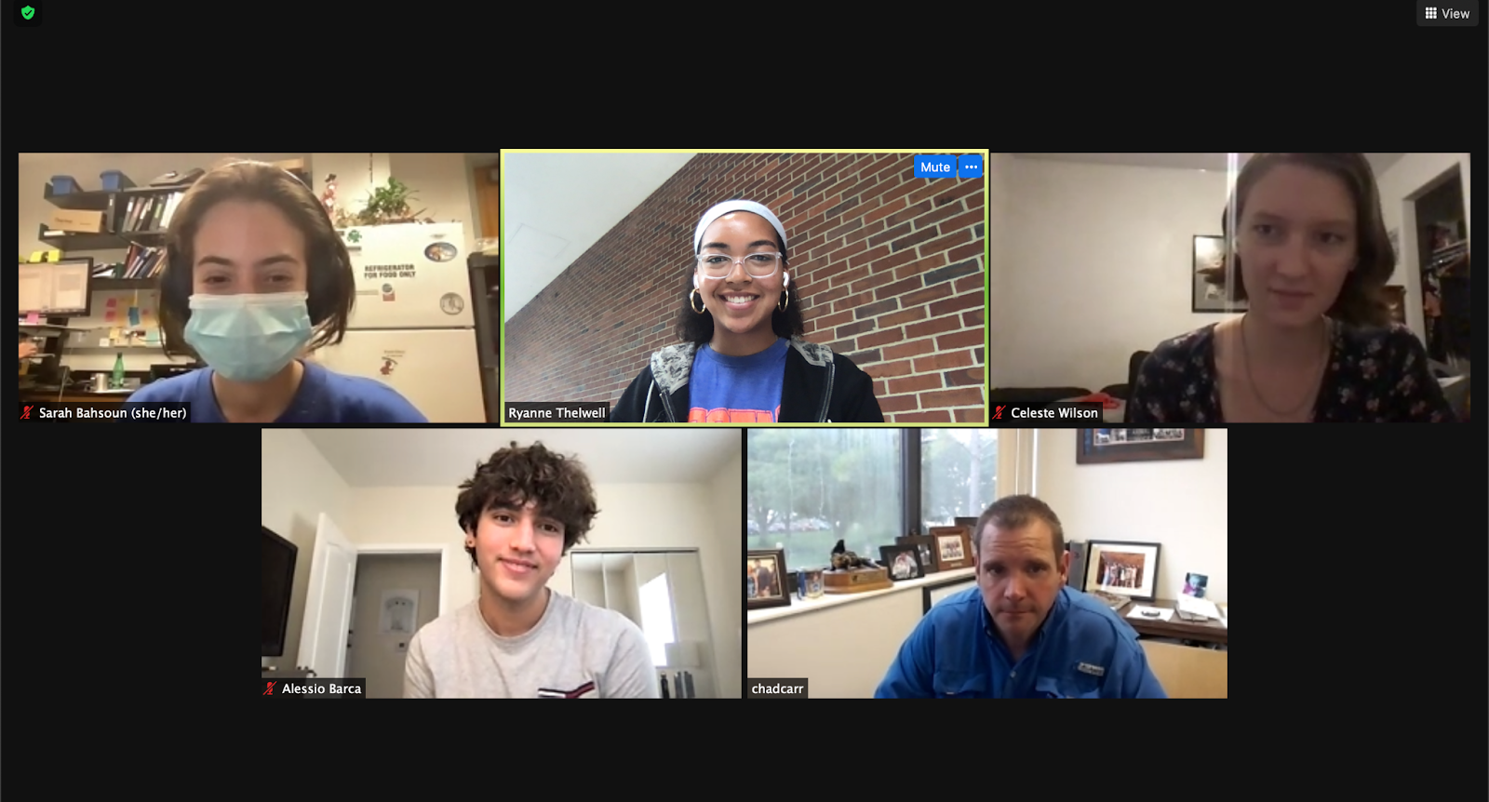
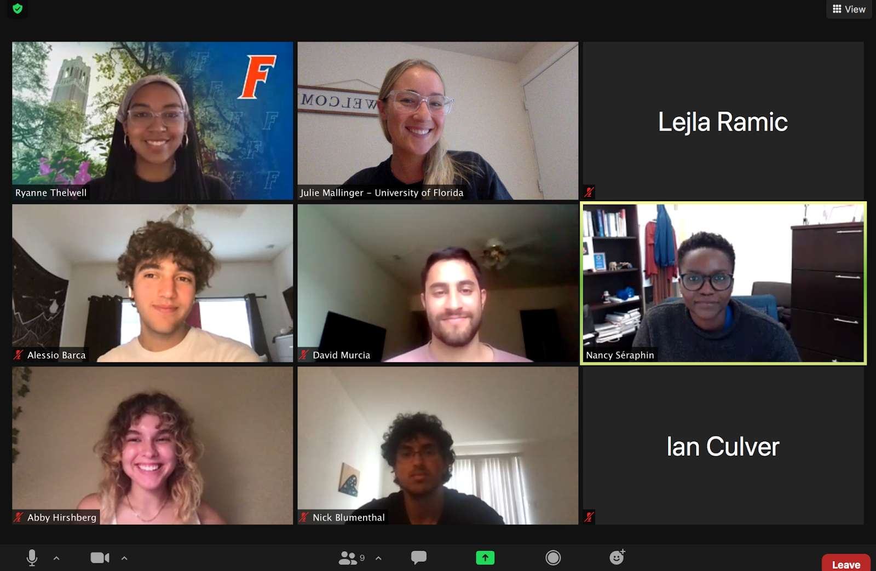
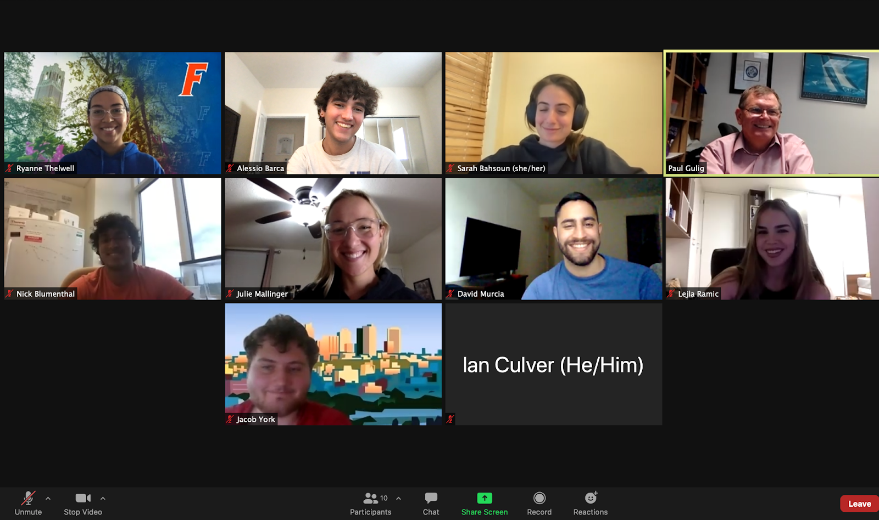
HUMAN PRACTICES
Notes:
Human practices works with the broader impact of the study. For example, I and [other present team members] are here today to hopefully help you learn a thing or two about antibiotic resistance and iGEM. We go out into our community to inform others so that they can better understand the world around them.
We consult professors from a wide variety of disciplines to understand the real-world implications of our project and make sure that what we’re doing actually has a premise. So far, we’ve consulted with professors specializing from crispr all the way to beef science, learning a lot along the way.

Slide 10
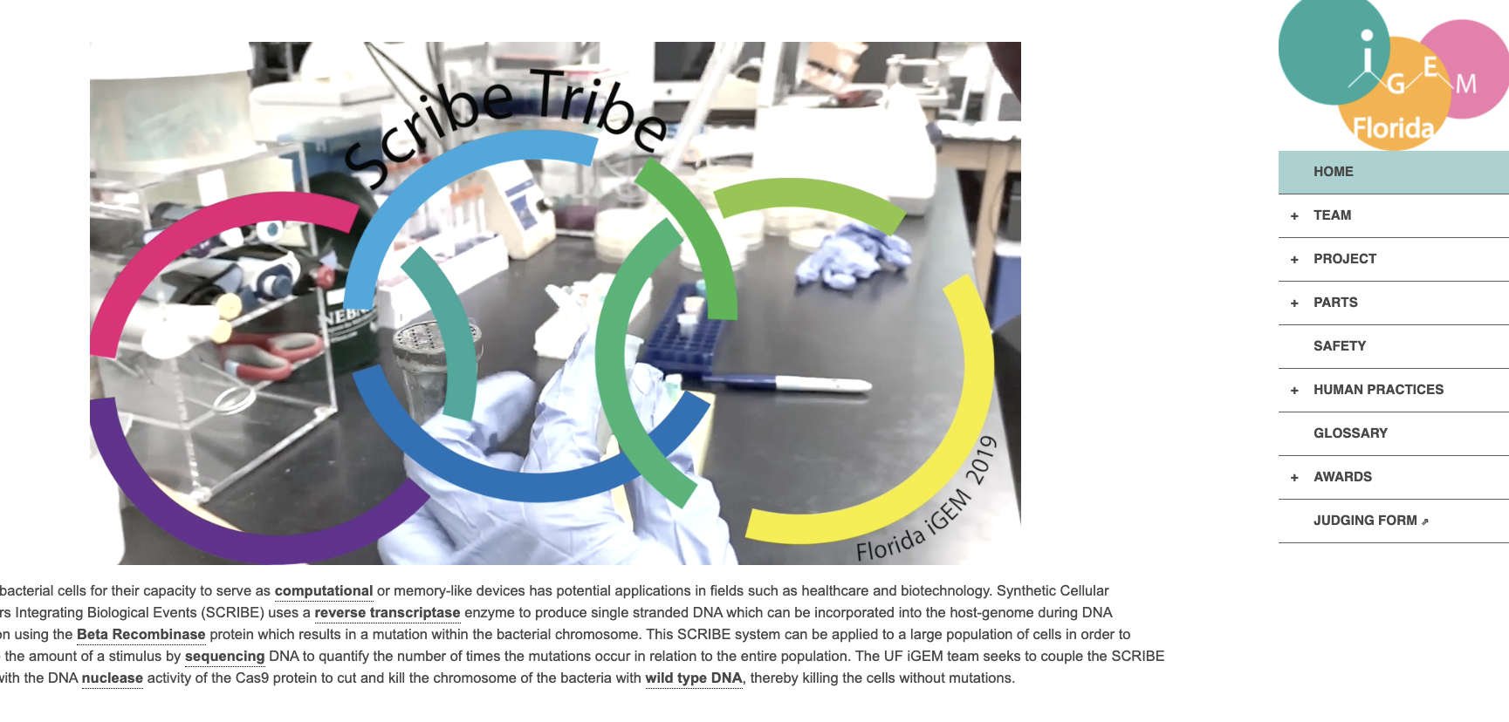

WIKI
Notes:
The WIKI team is in charge of coding our website. We start out with a blank slate and our wiki team is basically in charge of coding everything from scratch to build our website.
Here are a few examples of what our website has looked like in the past [click], [click]

Slide 11
WHO ARE WE?
Artists
Engineers
Programmers
Scientists
College of Liberal Arts and Sciences
College of Engineering
Notes:
So… who is UF iGEM? (click)
We are a team of scientists (click)
Programmers (click)
Engineers (click)
And artists (click)
From multiple colleges across campus (click twice)

Slide 12
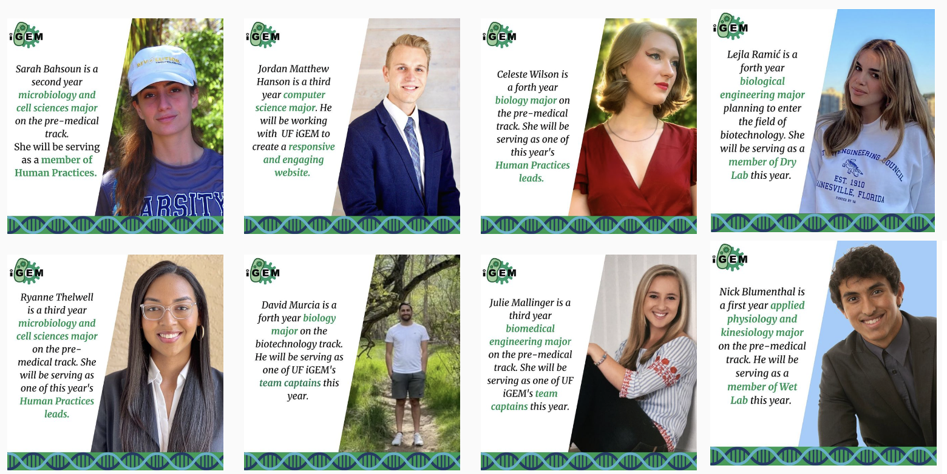
Notes:
This isn’t everyone, but just a few of highlight the diversity of backgrounds and education focus we have.
All of this is to emphasize that iGEM is a diverse competition in many ways-- we come from different educational backgrounds, different cultural backgrounds, working on a diverse array of projects and compete at an international level, where each team is diverse in its own way. We hope that this encourages you in the audience to be excited to participate in such diverse competitions and open to new ideas and new people.

Slide 13
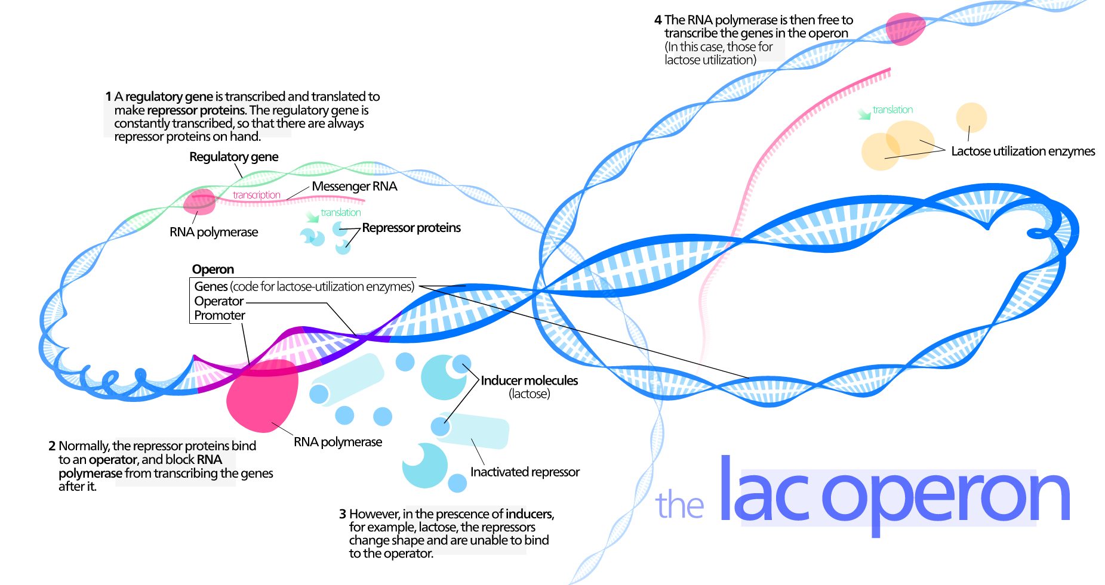
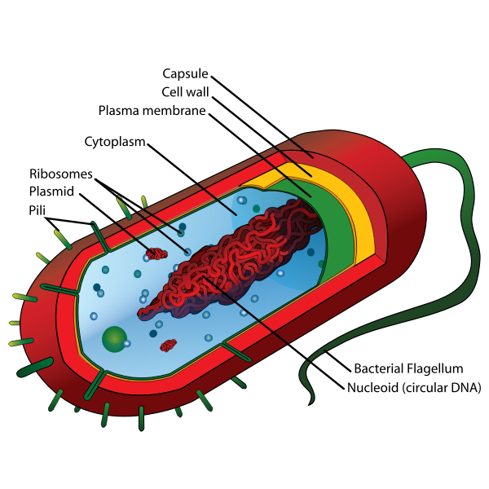
02 Our Project Part 1
Background Information
Our Goals
Notes:
So, section 2! We’re going to go over an introduction to our project, the background information, and the goals we set for ourselves. We hope that you guys are really able to learn about what the research process looks like in its most “organic” sense as we take you through our project.
Bacteria img src:
https://freesvg.org/img/Average-prokaryote-cell-en.png
Lac operon:
https://upload.wikimedia.org/wikipedia/commons/1/18/Operon.svg

Slide 14
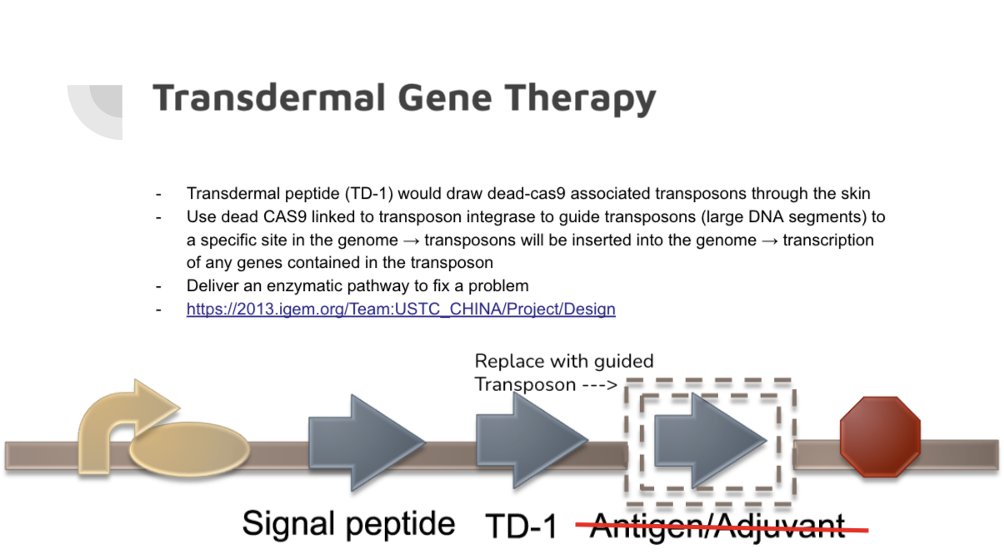

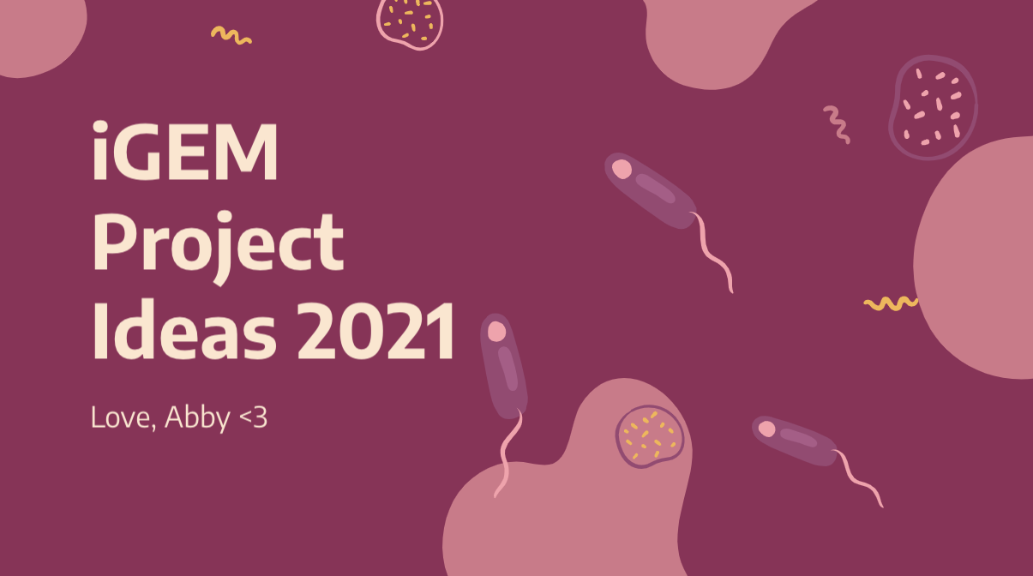
We wanted to tackle a problem...
So we just had several Zoom meetings where we brainstormed!
Notes:
We wanted to tackle a problem! Everyone on the team is passionate about solving a problem, and with the wide variety of backgrounds we come from we knew we could tackle just about anything. To figure out just what idea we wanted, we had a LOT of zoom meetings [click] just creating different presentations [click] and brainstorming different ideas [click twice]
And, we ended up choosing to tackle a project related to [switch slides]

Slide 15
ANTIBIOTIC RESISTANCE!
So what is that exactly?
Notes:
ANTIBIOTIC RESISTANCE!
[click]
So… what is that exactly ?
Does anyone in the audience want to type into the chat or go off of mute on what they think antibiotic resistance is?

Slide 16
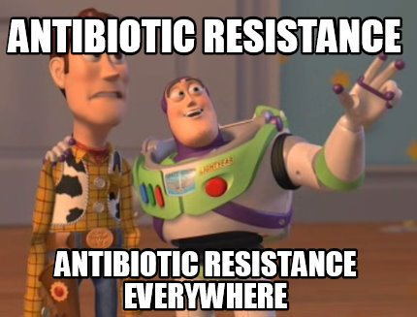
Antibiotic Resistance is...
Notes:
Antibiotic resistance happens when germs like bacteria and fungi develop the ability to defeat the drugs designed to kill them. That means the germs are not killed and continue to grow.
Infections caused by antibiotic-resistant germs are difficult, and sometimes impossible, to treat. In most cases, antibiotic-resistant infections require extended hospital stays, additional follow-up doctor visits, and costly and toxic alternatives.
Antibiotic resistance does not mean the body is becoming resistant to antibiotics; it is that bacteria have become resistant to the antibiotics designed to kill them.

Slide 17
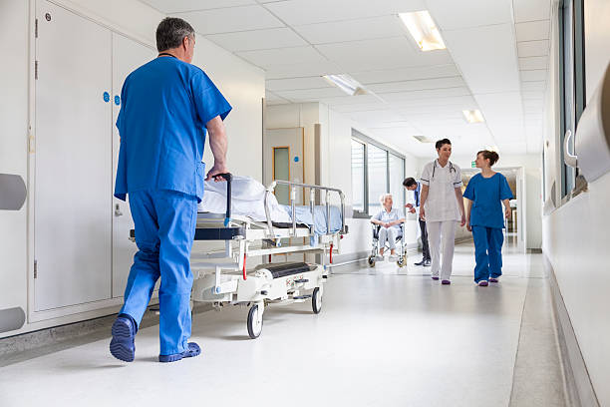

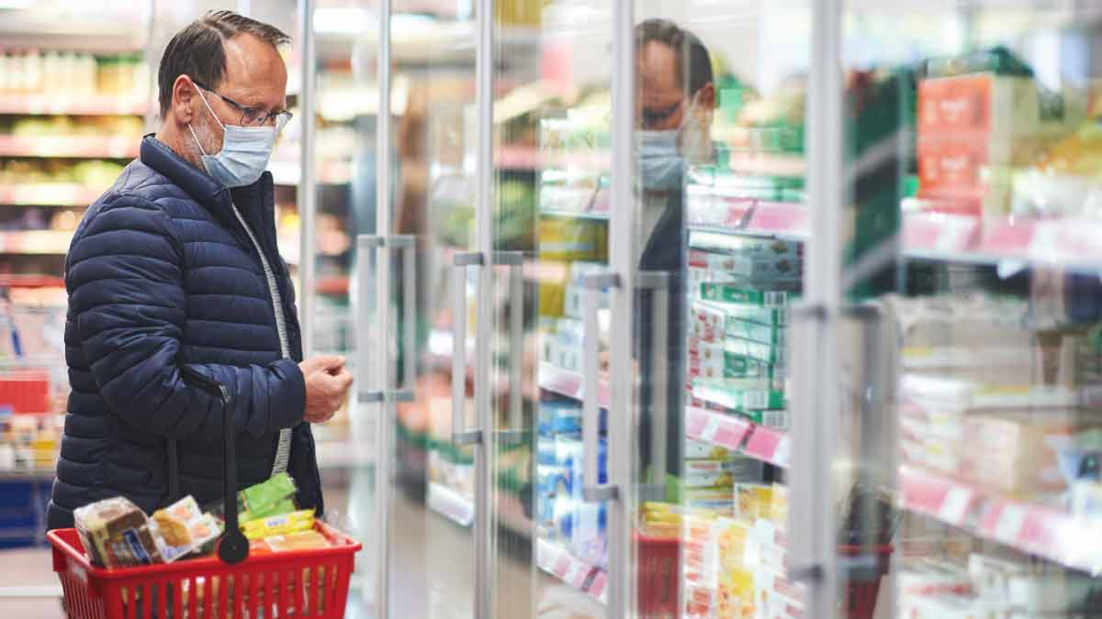
Antibiotic Resistance threatens everyone...
Notes:
Antibiotic resistance has the potential to affect people at any stage of life, as well as the healthcare, veterinary, and agriculture industries, making it one of the world’s most urgent public health problems.
Each year in the U.S., at least 2.8 million people are infected with antibiotic-resistant bacteria or fungi, and more than 35,000 people die as a result.
No one can completely avoid the risk of resistant infections, but some people are at greater risk than others (for example, people with chronic illnesses). If antibiotics lose their effectiveness, then we lose the ability to treat infections and control public health threats.
Many medical advances are dependent on the ability to fight infections using antibiotics, including joint replacements, organ transplants, cancer therapy, and treatment of chronic diseases like diabetes, asthma, and rheumatoid arthritis.

Slide 18

Vocabulary alert!
Notes:
So, we have our first vocabulary alert that we want you all to be aware of!

Slide 19
Antibiotic Resistance
Antimicrobial Resistance
Drug Resistance
all
mean
the same thing!
Notes:
For our purposes, antibiotic resistance is also referred to as antimicrobial resistance or drug resistance. While there is a difference, that doesn’t really concern our project. In most scenarios in fact, they all mean the same thing. So when you’re watching the news or reading an article about a new scientific advancement, assume that this all means the same thing.

Slide 20

WHERE DOES IT COME FROM?
Notes:
Next! Where does antibiotic resistance even come from?

Slide 21
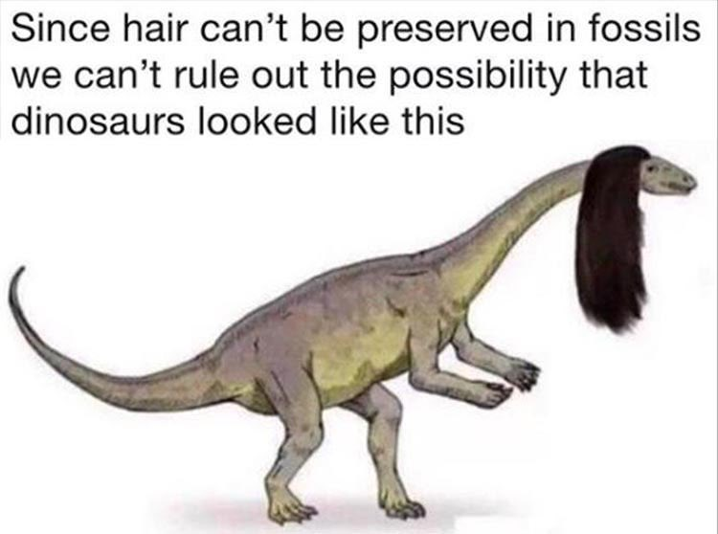
Quick review on evolution...
Individuals in a population show variation
Variations can be inherited
Organisms have more offspring that can survive under normal circumstances
Variations that increase reproductive success will have a greater chance of being passed on from generation to generation
A population will slowly change over time in response to the environment
Notes:
Remember your classes in elementary and middle school on Darwin’s principals of evolution. Well they are at play here. We’re going to review them really quickly before explaining how they apply to bacteria.
[Read these]
Individuals in a population show variation
Variations can be inherited
Organisms have more offspring that can survive under normal circumstances
Variations that increase reproductive success will have a greater chance of being passed on from generation to generation
A population will slowly change over time in response to the environment

Slide 22

So in terms of evolution...
Individuals in a population show variation → not all bacteria have the same exact genes
Variations can be inherited → bacteria with antibiotic resistance traits (at random!) can reproduce
Organisms have more offspring that can survive under normal circumstances → bacteria exponentially grow, favorably genes will be duplicated rapidly
Variations that increase reproductive success will have a greater chance of being passed on from generation to generation → bacteria with antibiotic resistance genes are more likely to survive and reproduce
A population will slowly change over time in response to the environment → this is why antibiotic resistance is a problem, there are resistant species emerging, not just individual colonies
Notes:
So in terms of evolution, [ just read the slide]

Slide 23
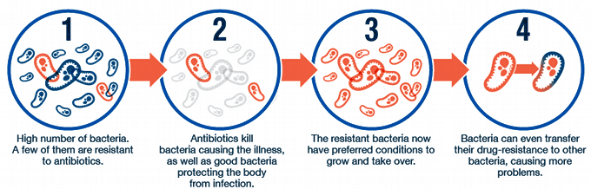
Notes:
This graphic illustrates just that, where [read]

Slide 24

So, really, where is this coming from?

Slide 25
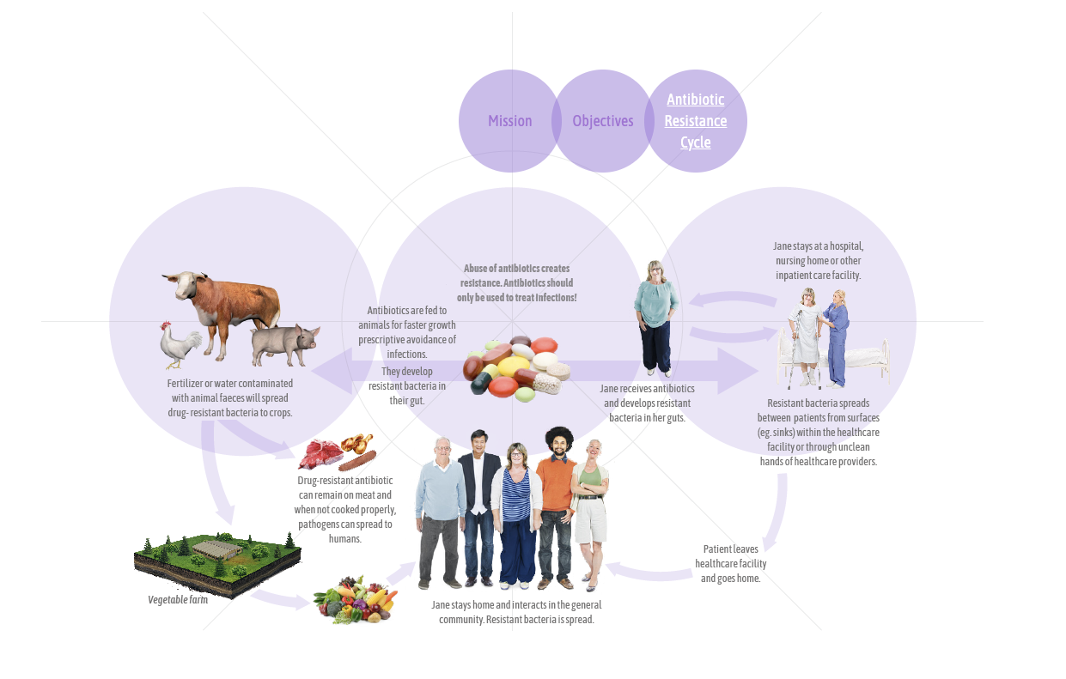
ABR Sources
Notes:
Antibiotic resistance comes from this cycle, and each graphic you see contributes to where antibiotic resistance “comes from” and how it perpetuates.

Slide 26
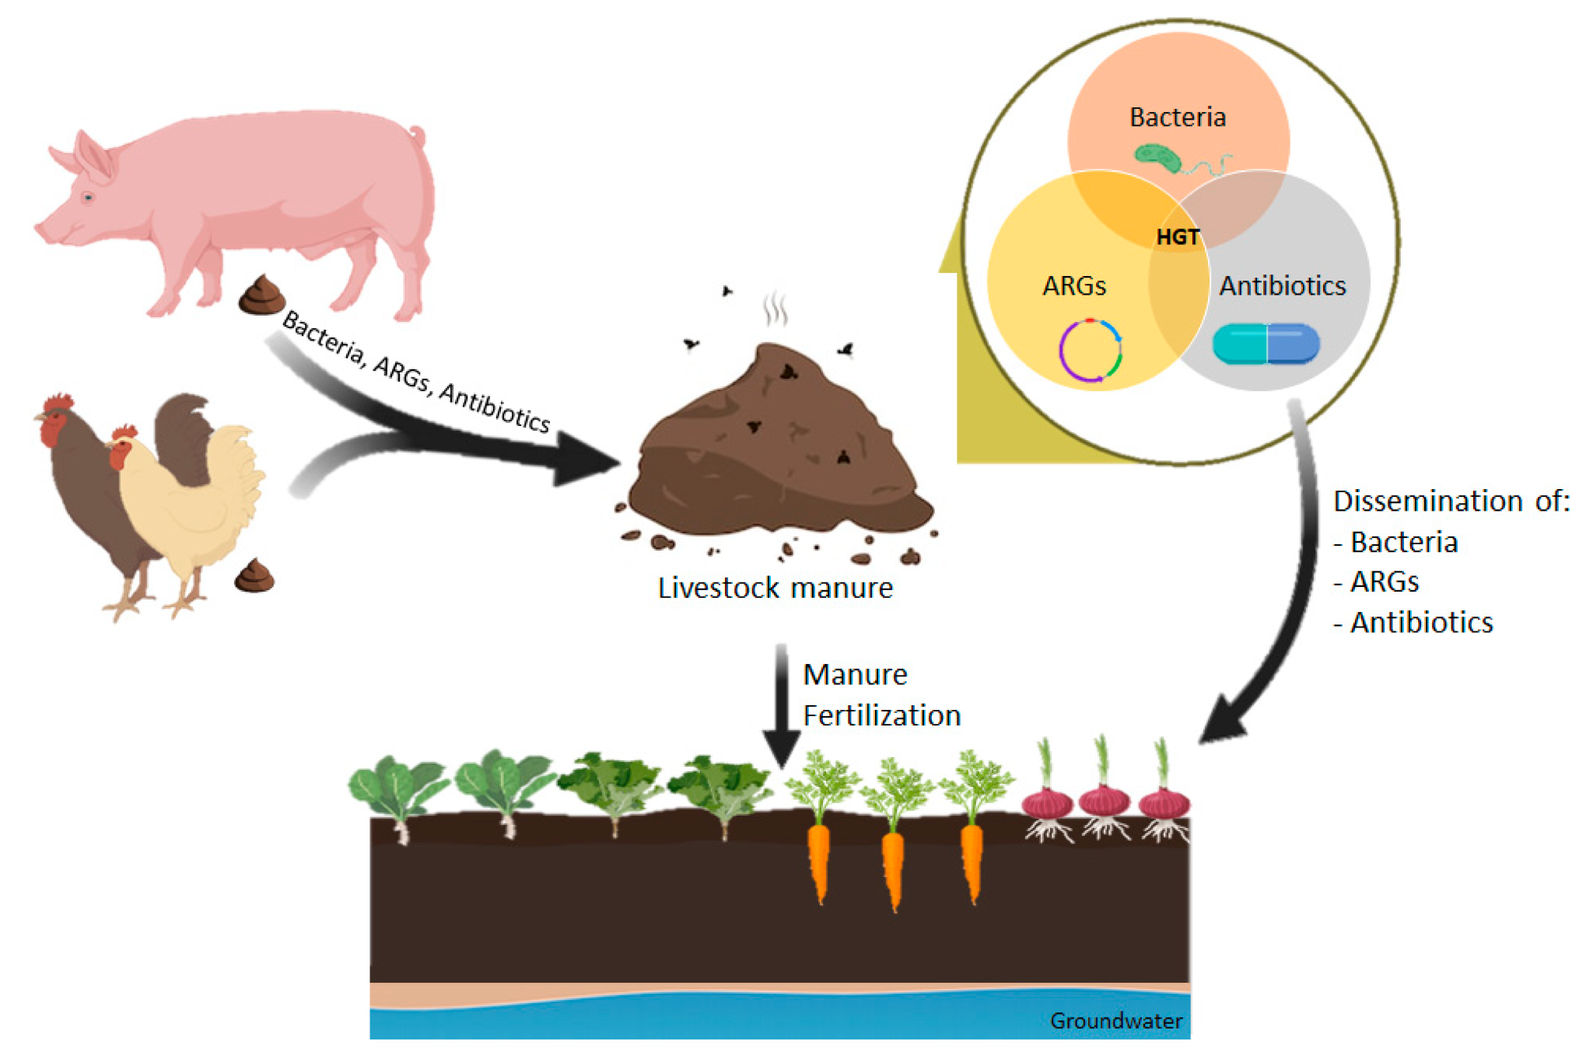

Slide 27

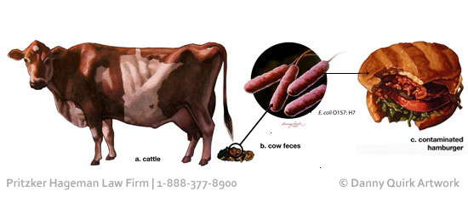
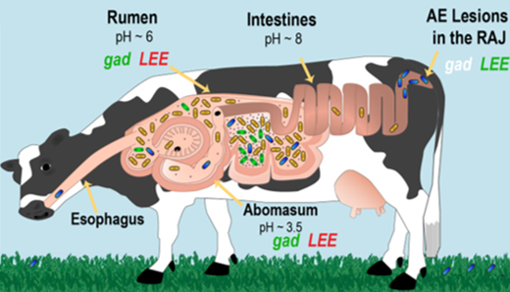
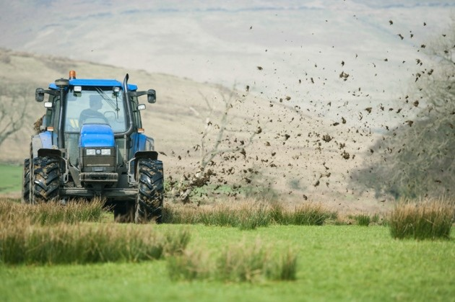

Slide 28
A brief history...

Slide 29
Select Germs Showing Resistance Over Time...
Antibiotic | Year Released | Drug Target | Resistant Germ Identified | Year Identified
Penicillin | 1941 | Bacterial cells with peptidoglycan cell walls | Penicillin-resistant Staphylococcus aureus Penicillin-resistant Streptococcus pneumoniae | 1942 1967
Methicillin | 1960 | Inhibiting bacterial cell-wall synthesis, similar to Penicillin | Methicillin-resistant Staphylococcus aureus | 1960
Fluconazole | 1988 | Inhibits fungal enzyme required for fungal cell wall synthesis. | Fluconazole-resistant Candida | 1990
Notes:
Penicillin, the first commercialized antibiotic, was discovered in 1928 by Alexander Fleming. Ever since, there has been discovery and acknowledgement of resistance alongside the discovery of new antibiotics. In fact, germs will always look for ways to survive and resist new drugs. More and more, germs are sharing their resistance with one another, making it harder for us to keep up.
If you look at this chart, notice how little after an antibiotic is released that a resistant germ is identified. For example, just a year after penicillin was first released a resistant germ was identified. Identified! That means it was in circulation, infecting people well before it was even identified.
We’ll go through this chart super quickly, because these are antibiotics that are super important to be aware of.
Read….

Slide 30
Vocabulary Alert!

Slide 31
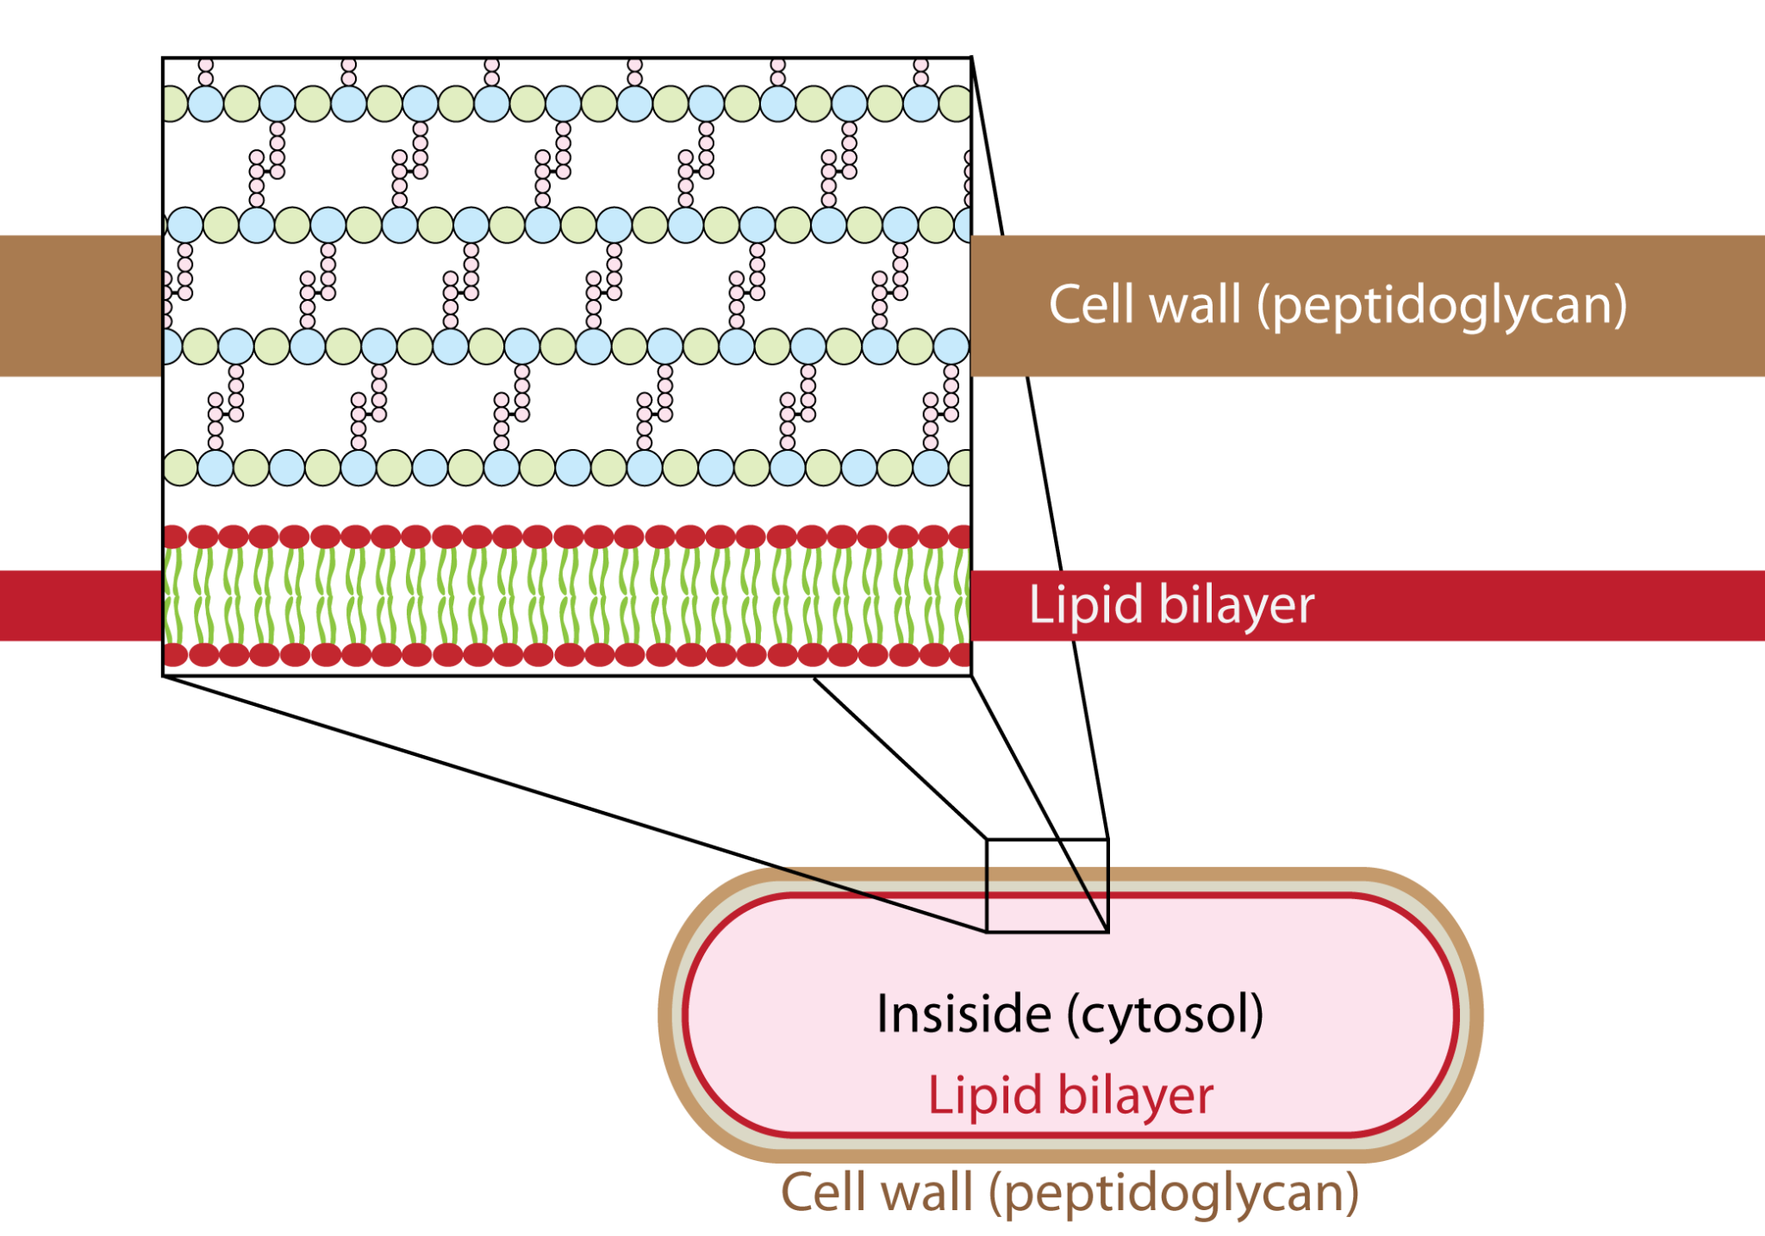
Peptidoglycan
What is it???
Notes:
Peptidoglycan is an incredibly important term to know when dealing with anything related to bacteria and pathogens. [click]
For those of you that have taken AP or IB bio, I’m sure you already know what this is!
Here’s a quick lesson on it for those of you that don’t know. [click]
Peptidoglycan is an essential and specific component of the bacterial cell wall found on the outside of the cell membrane (or in the case of this diagram, a lipid bilayer) of almost all bacteria.
Its main function is to preserve cell integrity by withstanding turgor pressure, which pertains to the pressure that is exerted by the fluid (e.g. water) against the cell wall. Peptidoglycan also contributes to the maintenance of a defined cell shape and serves as a scaffold for anchoring other cell envelope components such as proteins . It is intimately involved in the processes of cell growth and cell division.
VERY IMPORTANTLY, any inhibition of its biosynthesis (via mutation or antibiotic) during cell growth will result in cell lysis. This will kill the cell!
Remember the antibiotics we went over on the previous slides and their mechanisms of action? It was by targeting this peptidoglycan cell wall!
Image source:
https://upload.wikimedia.org/wikipedia/commons/2/2f/Peptidoglycan-membrane.png

Slide 32
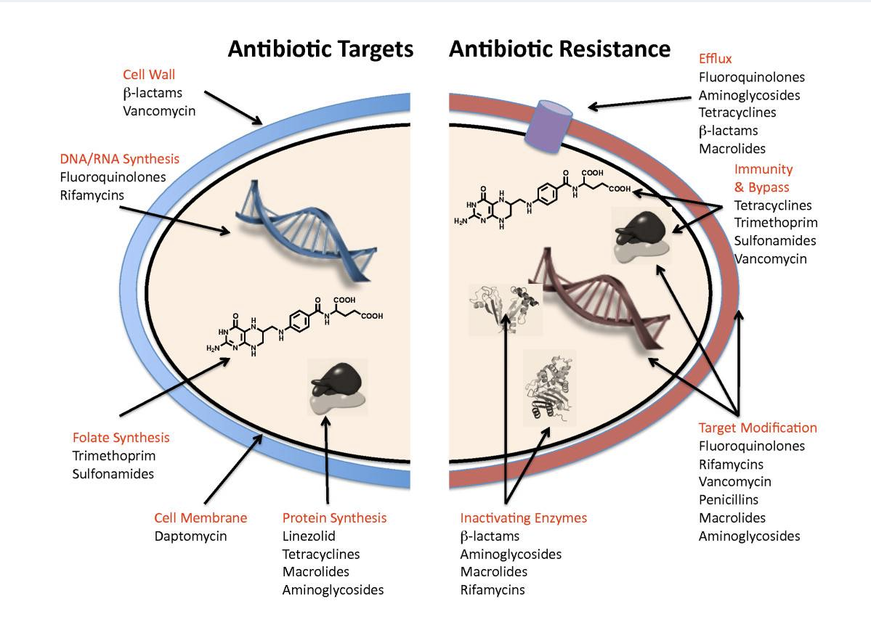
How do successful antibiotics work and what is the basis of resistance to them?
Notes:
We mentioned targeting the peptidoglycan wall. We’re going to dive in a little deeper and explain this further.
Antibiotics target essential bacterial physiology and biochemistry, causing microbial cell death or the cessation of growth. There are five major antibiotic targets: the bacterial cell wall, the cell membrane, protein synthesis, DNA and RNA synthesis, and folic acid (vitamin B9) metabolism (You can see all of this in this image).
These bacterial targets are different or nonexistent in eukaryotic cells (including those of humans), which means that antibiotics are relatively nontoxic drugs. For example, the β-lactam antibiotics such as penicillins, cephalosporins and carbapenems block the synthesis of peptidoglycan. This structure is absent in higher organisms but is essential for bacterial survival. The bacterial ribosome is the target of the tetracycline, aminoglycoside, macrolide and other antibiotics, and is sufficiently different from the eukaryotic ribosome that cross-inhibition does not occur.
Resistance to antibiotics occurs through four general mechanisms: target modification; efflux; immunity and bypass; and enzyme-catalyzed destruction (which you can also see in the figure). Target modification can occur through mutation of the targets themselves - for example, the production of enzymes that modify antibiotic targets, as, for example, in ribosomal methylation. Efflux occurs through a large family of protein pumps that eject antibiotics from inside the cell. In immunity, antibiotics or their targets are bound by proteins that prevent the antibiotic binding to its target. Arguably, the most specific and evolved mechanism of antibiotic resistance are enzymes that recognize antibiotics and modify them in such a way as to eliminate the functional characteristics that enable them to interact with their targets. For example, β-lactamases hydrolytically cleave the core β-lactam ring that is characteristic of the class and essential to antibiotic action.

Slide 33
People are misusing them
They are overused
The Problem with Current Antibiotics….
They rely on similar mechanisms of action
Don’t stop when you “feel better.”
Finish the entire course.
Listen to your doctor!
Overprescribed, sometimes even asked for when not needed.
Targeting the peptidoglycan wall (for example)
Notes:
This is exactly part of the problem of current antibiotics. [click]
They rely on similar mechanisms of action, by targeting the peptidoglycan wall, at times, nonspecific to the bacteria. [click]
But as a human, you host many different types of bacteria within your body, some natural. But, if they are subjected to this antibiotic, they may mutate and develop their own resistance which was not originally intended. This problem of antibiotic resistance is exacerbated because of how antibiotics are misused by the public [click]
Many people stop taking antibiotics when they begin to feel better. THAT IS WRONG! When you do that, and don’t finish the entire course of your treatment, you leave behind extra surviving bacteria that may develop resistance, leading to the very problem we are discussing! [click]. Make sure you listen to your doctor!
The third problem we’ll go over is the fact that antibiotics are simply overused. Doctors prescribe antibiotics for different reasons. Sometimes they prescribe them when they're not sure if an illness is caused by bacteria or a virus or are waiting for test results. So, some patients might expect a prescription for an antibiotic and even ask their doctor for it. [click]
For example, strep throat is a bacterial infection, but most sore throats are due to viruses, allergies, or other things that antibiotics cannot treat. But many people with a sore throat will go to a health care provider expecting — and getting — a prescription for antibiotics that they do not need.

Slide 34
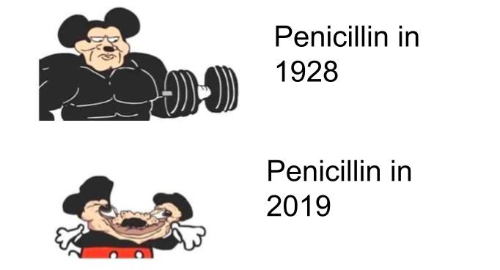
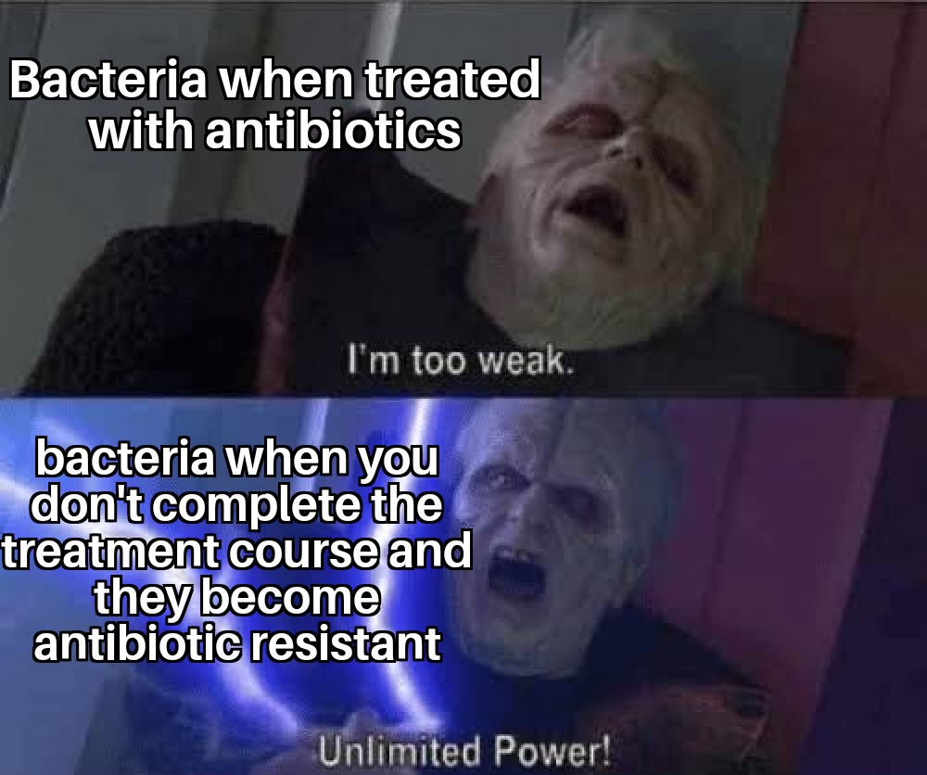
Antibiotic Misuse results in….
Notes:
So while antitiobic resistance is a natural phenomena, the misuse by humans has made it much much worse especially in the past few decades.

Slide 35
Our Plan
Providing alternative selectable markers that do not rely on antibiotic resistance genes
Alternative selectable markers are genes we can alter to produce obvious, observable effects.
They allow us to determine which cells have been genetically altered and which have not.
How to test?
Give bacteria a plasmid of interest with our DNA of interest (via conjugation)
Cells that have taken up DNA of interest (with an antibiotic resistance marker on it) will be able to survive when plated on the respective antibiotic while those who have not taken up the DNA of interest will die when plated on the antibiotic
This is important in bacterial transformations because we want to see if a cell took up a plasmid of interest
Notes:
With these problems in mind, we set out to determine a more novel and experimental way to target bacteria without going for antibiotic resistance genes that may be over-targeted (such as those that control the peptidoglycan synthesis).
Our plan is to {read off of slide}
What are selection markers? Selection markers are chemical tools that scientist use in order to perform studies with bacteria and make sure that the gene of interest they want to insert into the bacteria is working. So you may be asking, how do they work? Well lets give an example/metaphor. Let’s say that you want to grow bacteria in a lab and you want them to glow green by using a gene that codes for a protein, proteins are basically robots that perform specific task and our bodies have trillions of them. This specific green glowing protein/robot gene we want to insert will allow the bacteria we are working with to glow green.
So in order for us to insert the code that makes that green glowing protein, we need to find ways to make sure our bacteria take in those instructions and use them. We have to remember that bacteria are living organisms like us and their main goal is to survive and not produce a green glowing protein that us humans want them to read. So a way in which we can make/force them to do this task is by putting them in an environment where they are at risk of dying. So for example antibiotics are selection markers. They kill bacteria and in order for the bacteria to survive they need to learn the instructions(gene) that code for a protein/robot that will destroy the antibiotic and make the bacteria become antibiotic resistant. So what we do here is we create a dna design in which we give them the instructions on how to destroy the antibiotic and right next to those instructions we have also placed the instructions on to glow green, which forces them to actually say oh no ...we need to survive so in order to survive we the bacteria will take this piece of dna that that will make us resistant to the antibiotic and AHA! We have tricked them into also glowing green due to putting both instructions right next to each other. So every time they want to create robots to survive and kill the antibiotic they are surrounded by, they will also glow green, which lets us know our genetic trick worked!
So in summary, selection markers are great tools for genetic engineering and here at UF igem we are looking for different ways to make genetic engineering by forcing bacteria to take green glowing genes without using antibiotics and thus become resistant to them. And then using those same bacteria and make them turn into hunters that will actually kill antibiotic resistant bacteria through molecular scissors called crispr via a transportation system called conjugation.
This type of research allows for better ways of genetic engineering and also to hunters of bad bacteria without actually making those hunters antibiotic resistant as well!

Slide 36
Our Plan continued....
We will be testing for carbon sources as positive selection markers
Sucrose, arabitol, and ribitol → see if we can transform cells and give them the ability to metabolize these sugars → will be able to test for transformants
Notes:
Continue reading, then move on

Slide 37
03 Our Project Part - The Science Stuff!
Notes:
So now we are onto part 2 , which is the real science stuff ! We’re gonna go into a little more in depth into our project, but more importantly, introduce you to the methods we employ and the equipment we use. If you are planning on majoring in science in college, or even doing a nifty science project next year, this will be important for you to be familiar with.

Slide 38
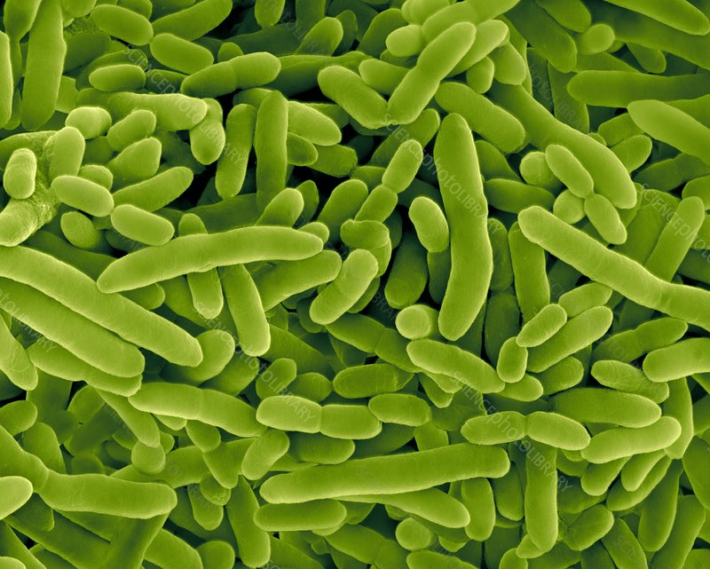
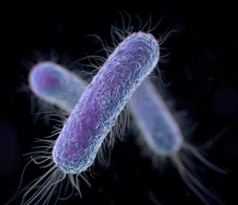
Bacteria we are using
Pseudomonas putida
E. Coli
Notes:
Pseudomonas putida is a Gram-negative, rod-shaped, saprotrophic soil bacterium.
Escherichia coli, also known as E. coli, is a Gram-negative, facultative anaerobic, rod-shaped, coliform bacterium of the genus Escherichia that is commonly found in the lower intestine of warm-blooded organisms.
Both are associated with antibiotic resistance and fooborne illness. We have selected them for use in particular because of their availability to us and because we can use them in our BSL1 lab. You’ll find that a lot of projects are constrained by the resources they have, and this is one of them, but that’s just part of the process.

Slide 39
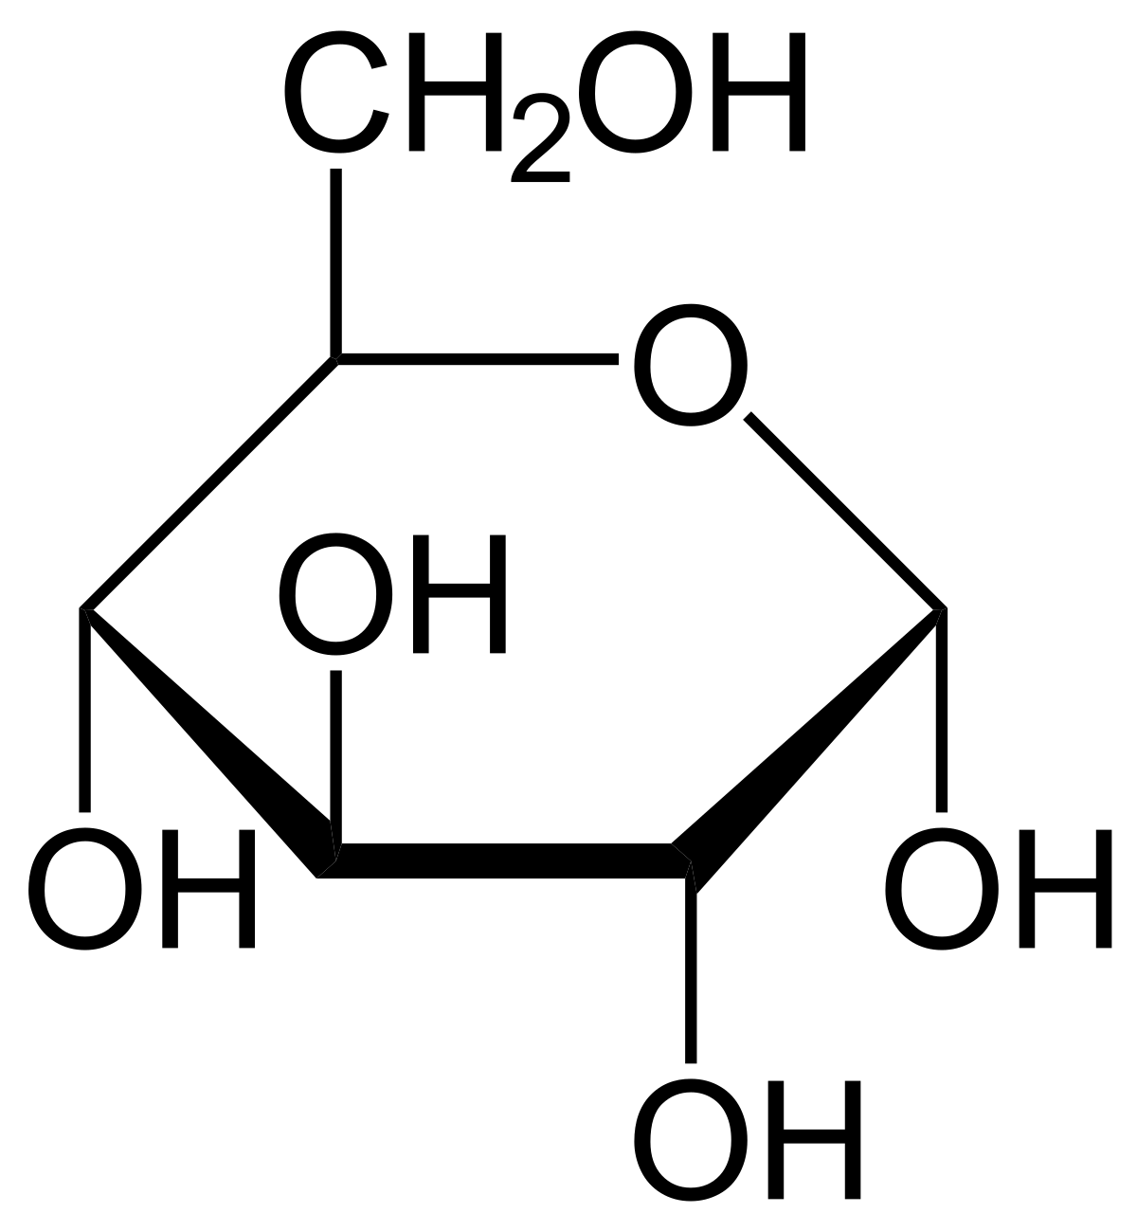
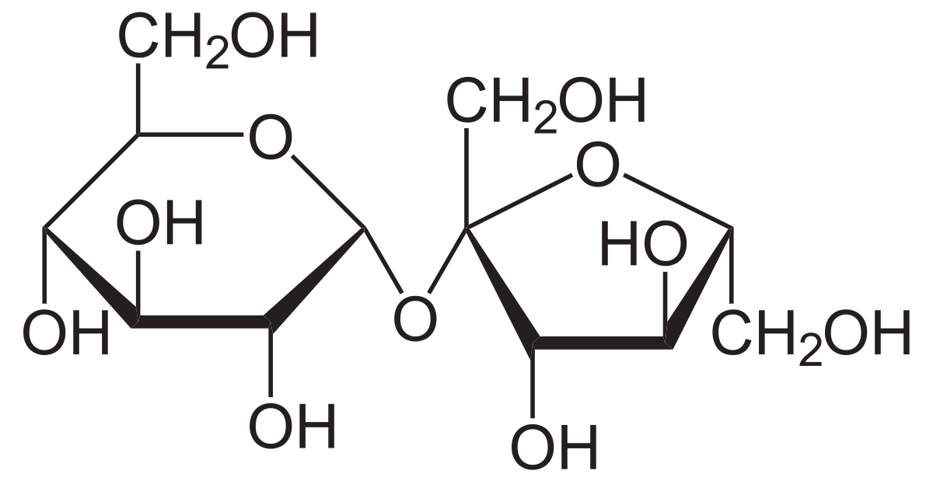
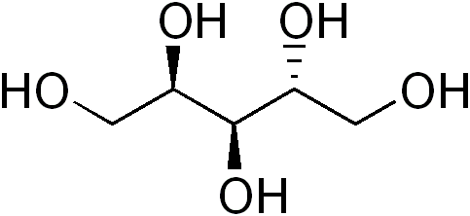
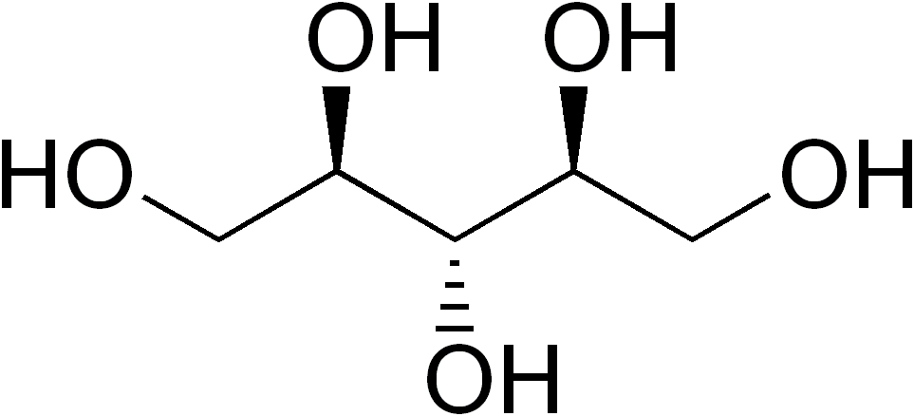
Sugars we are working with...
Sucrose
Arabitol
Glucose
Ribitol
Notes:
The sugars we are working with are
[list]
THe reason we selected these sugars is because in order to validate if our bacteria conjugated our plasmids, they should or should not be able to grow on some of these sugars. This is an easy way to validate the conjugation success without doing any fancy procedures or genetic testing.

Slide 40
Wet lab has been busy...
30
31
1
2
3
4
5
Lab Day
Research
Lab Day
Lab Day
Lab Day
6
7
8
9
10
11
12
Lab Day
Lab Day
Lab Day
Lab Day
Meeting
Lab Day
13
14
15
16
17
18
19
Lab Day
Test
Test
Test
20
21
22
23
24
25
26
27
28
29
30
31
1
2
Notes:
And… we have been busy…

Slide 41
Our progress!
So far we have….
Made plasmids with each of the four sugar pathways
Made each plasmid with a backbone including antibiotic resistance
Prepared plates with our sugars and put our bacteria on their plates with corresponding inducers
Notes:
A plasmid is a genetic structure in a cell that can replicate independently of the chromosomes, typically a small circular DNA strand.

Slide 42
METHODOLOGY and EQUIPMENT
PCR
Jupiter is a bright object in the night sky
Pipettes, Centrifuges, Autoclaves, Plates
Gel Electrophoresis
Venus has a beautiful name and it’s hot
Saturn is composed of hydrogen and helium
Notes:
Since a lot of the mechanisms we discuss may be out of scope for you all for the next few years, we wanted to elaborate a little more and introduce you to the lab procedures we employ because that WILL probably be important for your AP bios and beginning Bios in college.

Slide 43
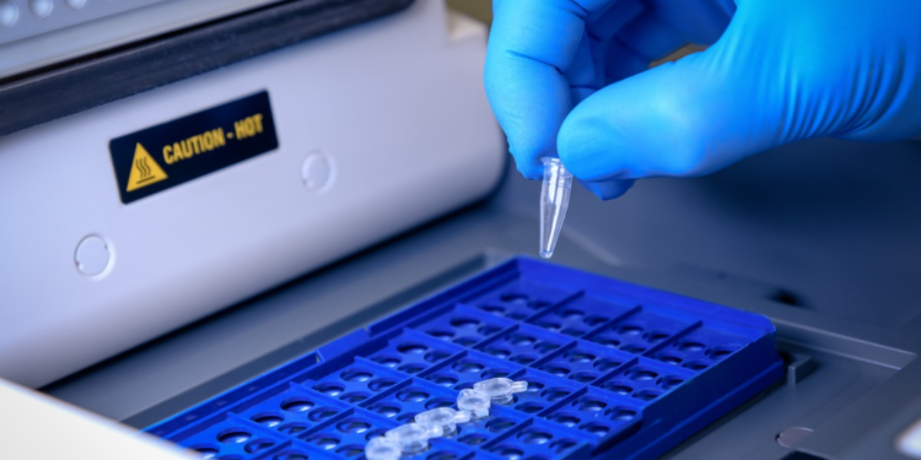
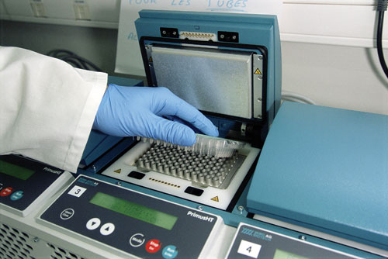
PCR
Polymerase Chain Reaction
Notes:
PCR is a super important method that we hope to go over with you all today.
PCR stands for Polymerase Chain Reaction
So what is it?
Sometimes called "molecular photocopying," the polymerase chain reaction (PCR) is a fast and inexpensive technique used to "amplify" - copy - small segments of DNA. Because significant amounts of a sample of DNA are necessary for molecular and genetic analyses, studies of isolated pieces of DNA are nearly impossible without PCR amplification.
Once amplified, the DNA produced by PCR can be used in many different laboratory procedures. For example, most mapping techniques in the Human Genome Project (HGP) relied on PCR.
PCR is also valuable in a number of laboratory and clinical techniques, including DNA fingerprinting, detection of bacteria or viruses (particularly AIDS), and diagnosis of genetic disorders.

Slide 44
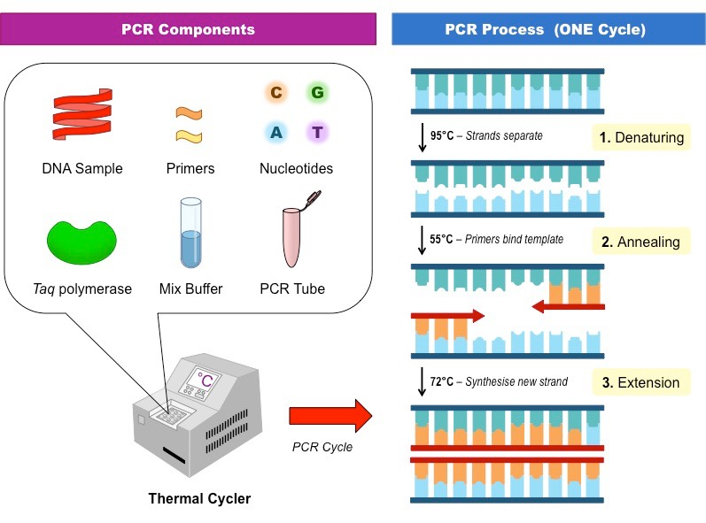
So how does PCR work?
Notes:
To amplify a segment of DNA using PCR, the sample is first heated so the DNA denatures, or separates into two pieces of single-stranded DNA. Next, an enzyme called "Taq polymerase" synthesizes - builds - two new strands of DNA, using the original strands as templates. This process results in the duplication of the original DNA, with each of the new molecules containing one old and one new strand of DNA. Then each of these strands can be used to create two new copies, and so on, and so on. The cycle of denaturing and synthesizing new DNA is repeated as many as 30 or 40 times, leading to more than one billion exact copies of the original DNA segment.
The entire cycling process of PCR is automated and can be completed in just a few hours. It is directed by a machine called a thermocycler, which is programmed to alter the temperature of the reaction every few minutes to allow DNA denaturing and synthesis.

Slide 45
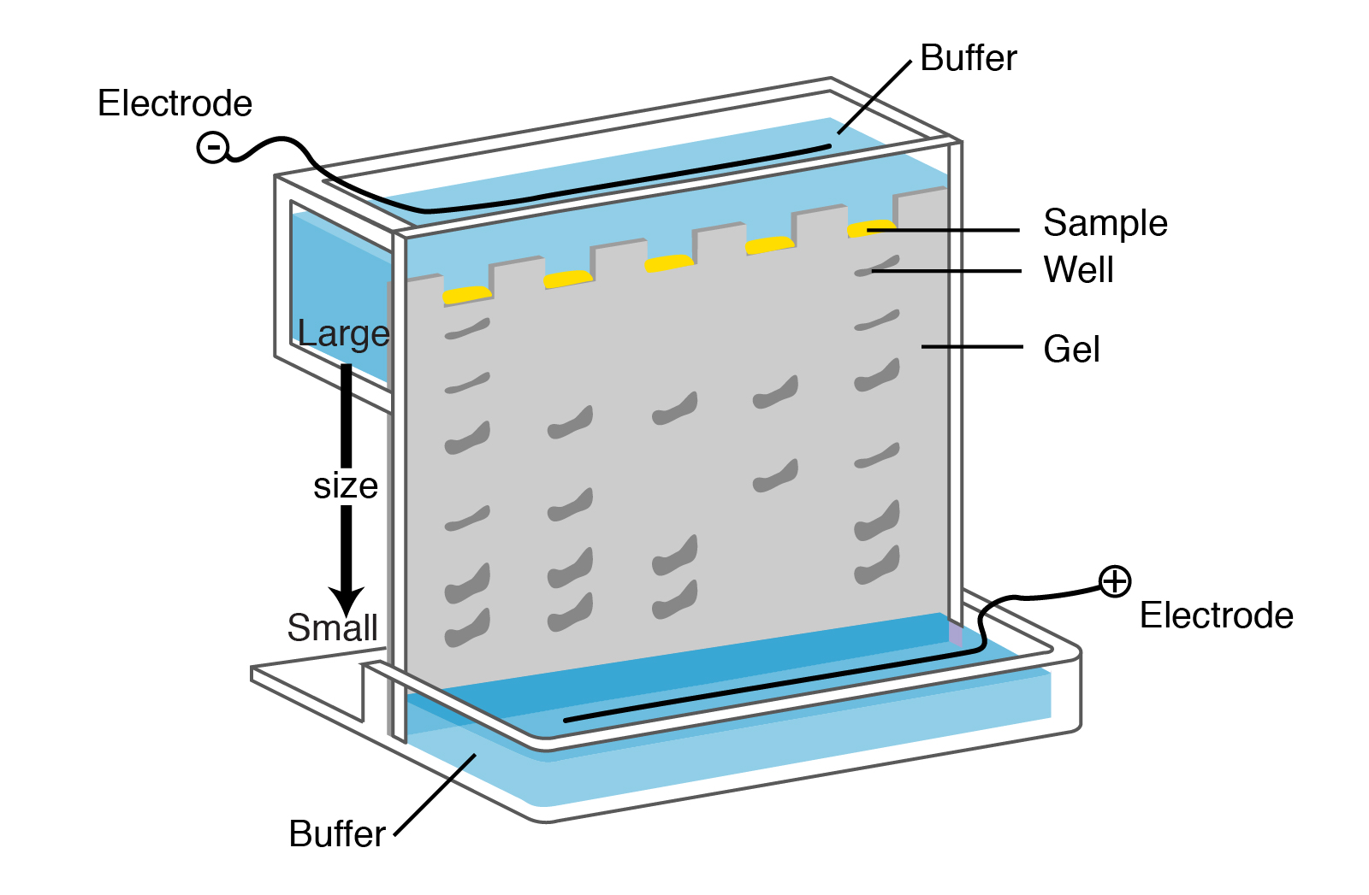
GEL ELECTROPHORESIS
Notes:
Electrophoresis is a laboratory technique used to separate DNA, RNA, or protein molecules based on their size and electrical charge. An electric current is used to move molecules to be separated through a gel. Pores in the gel work like a sieve, allowing smaller molecules to move faster than larger molecules. The conditions used during electrophoresis can be adjusted to separate molecules in a desired size range.
Electrophoresis is a very broadly used technique which, fundamentally, applies electric current to biological molecules, whether--they're usually DNA, they can be protein or RNA, too...and separates these fragments into pieces which are larger or smaller. It's used in a variety of applications... Everything from forensics for determining the identity of individuals that may have been involved in a crime, by linking their DNA pattern, their electrophoresis pattern, to one that's in a database. They're also very important in protein research, and then genetic mutation research, because when proteins or DNA are mutated, they are frequently longer or shorter, and they therefore show up on an electrophoresis gel differently than normal, so many diagnostic tests are still done using electrophoresis, so it's a very widely used basic research technique, was very important for the understanding of gene and protein function, but it's now gotten into the area of clinical diagnostics and forensics as well.

Slide 46
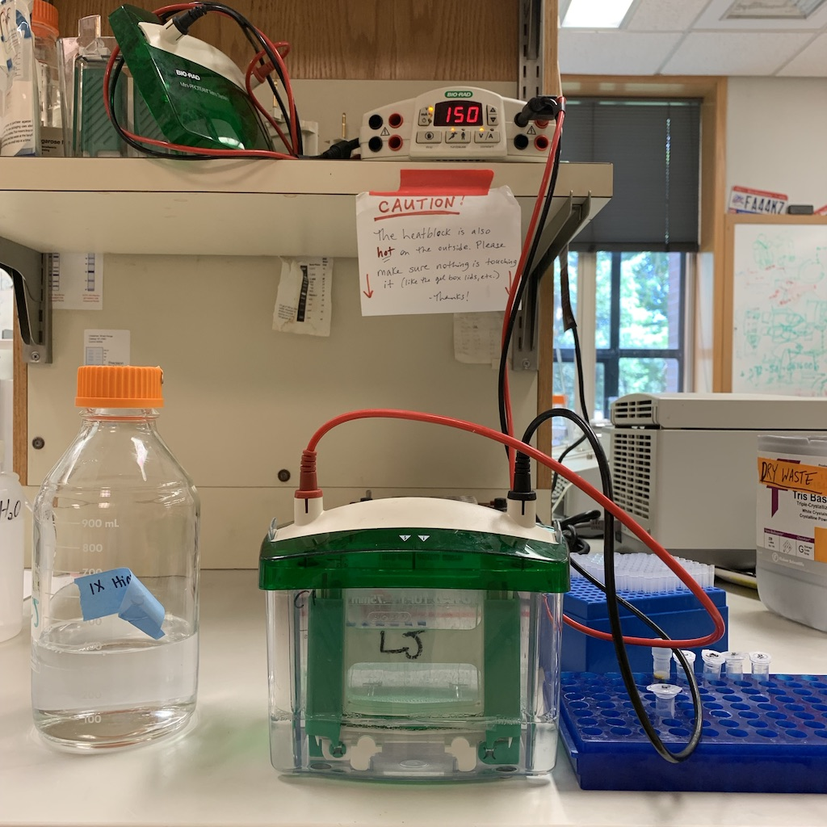
Gel Electrophoresis continued….
Notes:
Electrophoresis is usually done in what looks like a box which has a positive charge at one end and a negative charge at the other. And as we all learned in basic physics, when you put a charged molecule into an environment like that, the negative molecules go to the positive charge, and vice versa. In looking at proteins in a gel, in one of these boxes, you usually take the entire protein, and you're looking at the entire length of the protein and seeing how big it is, and the bigger it is, the shorter it will migrate into the gel, so that the small proteins will end up at the bottom of the gel, because they have migrated the farthest, and the biggest ones will wind up staying at the top.

Slide 47
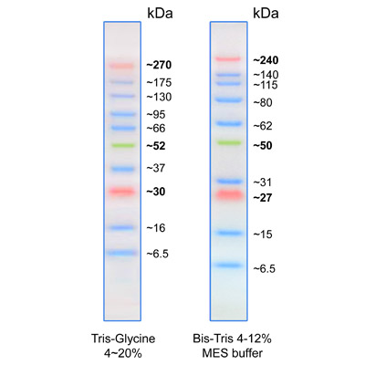
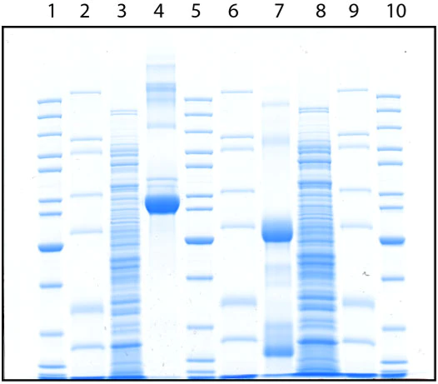
The end result!
Notes:
At the end of the gel electrophoresis procedure, you get what’s called a western blot. Western blotting can produce qualitative and semi-quantitative data about the protein of interest.
For example, if you want to test if bacteria have taken up a particular gene that you wanted from a plasmid, you could run gel electrophoresis, take a look at the western blot, look at the ladder to find the correct molecular weight, and see if there is a band at that particular weight. If not, you’ll probably have to start over. Oh, and the ladder is usually [explain].

Slide 48
EQUIPMENT
Just the basics….
Notes:
SO now for the equipment, just the basics that you will eventually use if you ever take a micro class or do research!

Slide 49
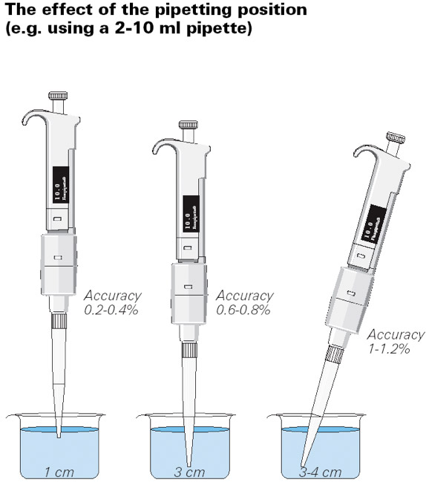
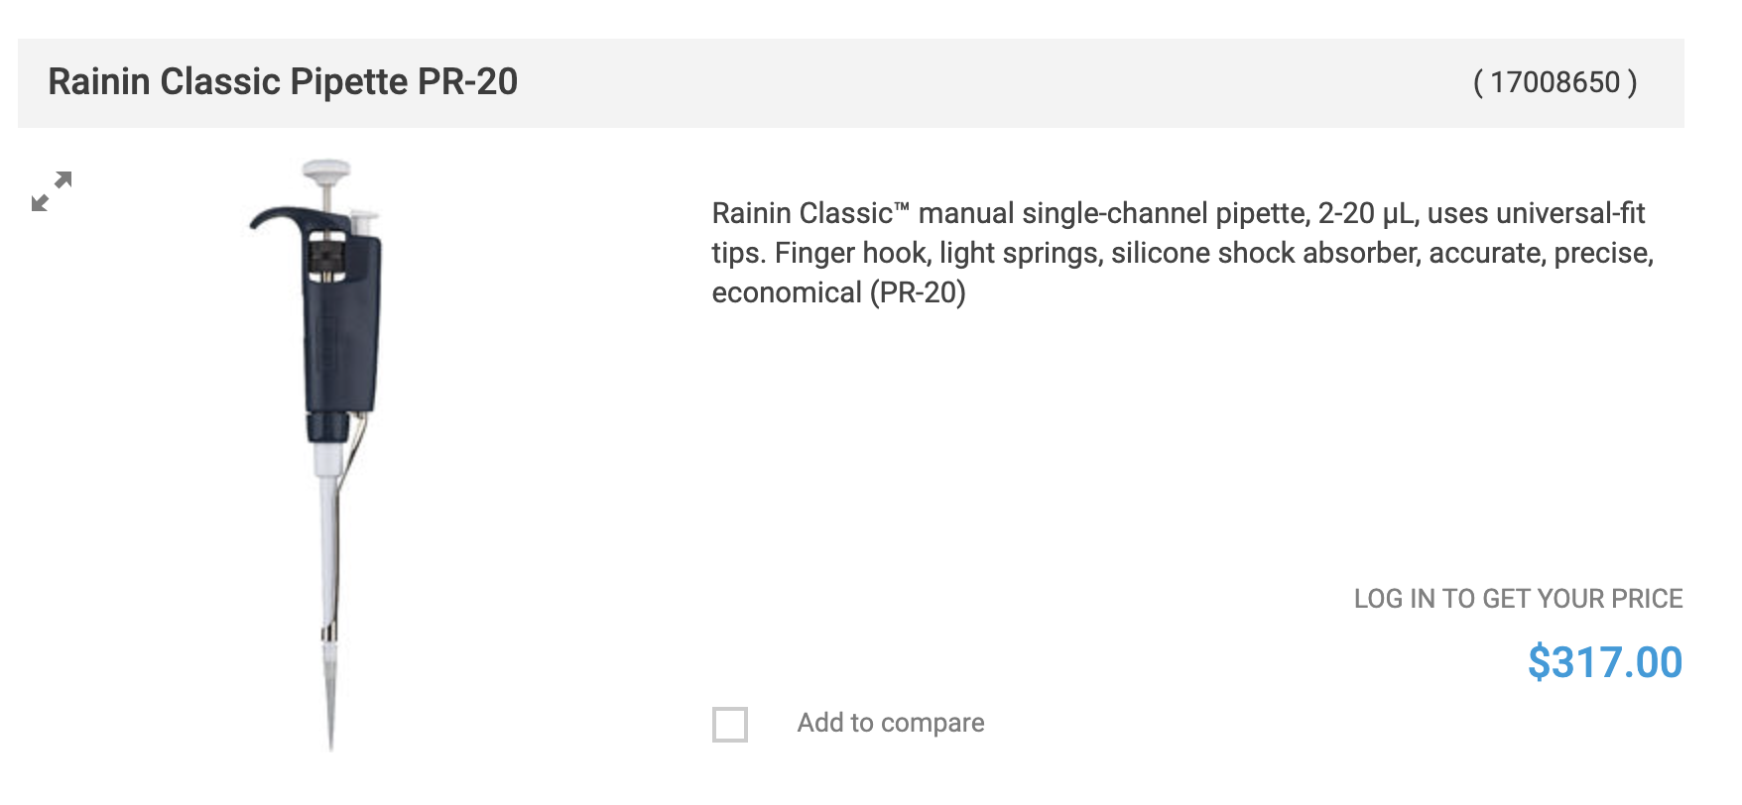
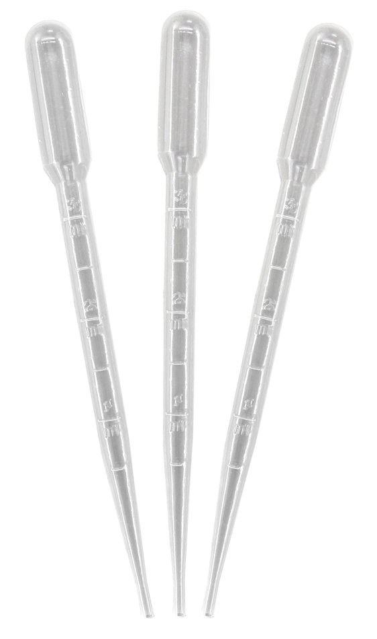
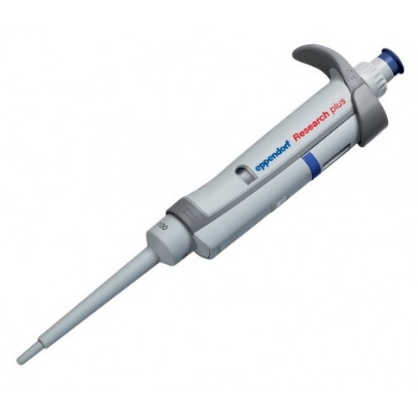
Pipettes
Notes:
A pipette is basically just used for measuring precise volumes of chemicals and transferring them to different test tubes and beakers. There are different types, and we mostly use the ones on the far right, which give us the precise volumes we need. We’re working with microliters here, so we need to be as precise as possible.
And don’t be fooled by their size, these babies are also pretty pricey [click] -- one is hundreds of dollars if you get a good one.
Pipetting technique is also super important [click]. If you look at the graphic, [explain]

Slide 50
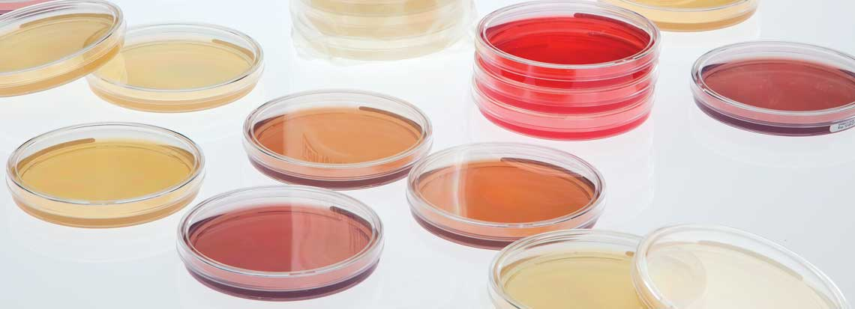
Plates
Notes:
Plates, also known as petri dishes are essential to our research. That’s where our bacteria grow!
They don’t just grow on the plates, they grow on a jello like substance called agar which is filled with nutrients they need to grow and thrive.
In some experiments, you can alter this agar to validate certain experimental conditions, such as in ours!

Slide 51
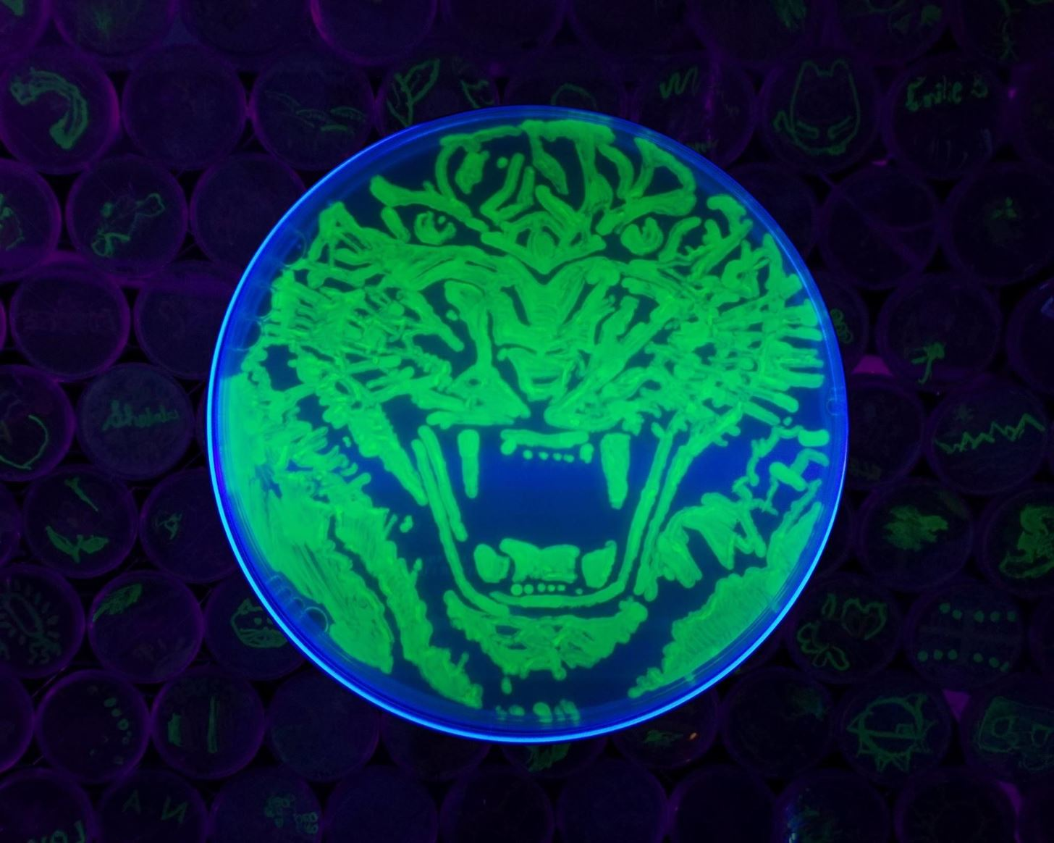
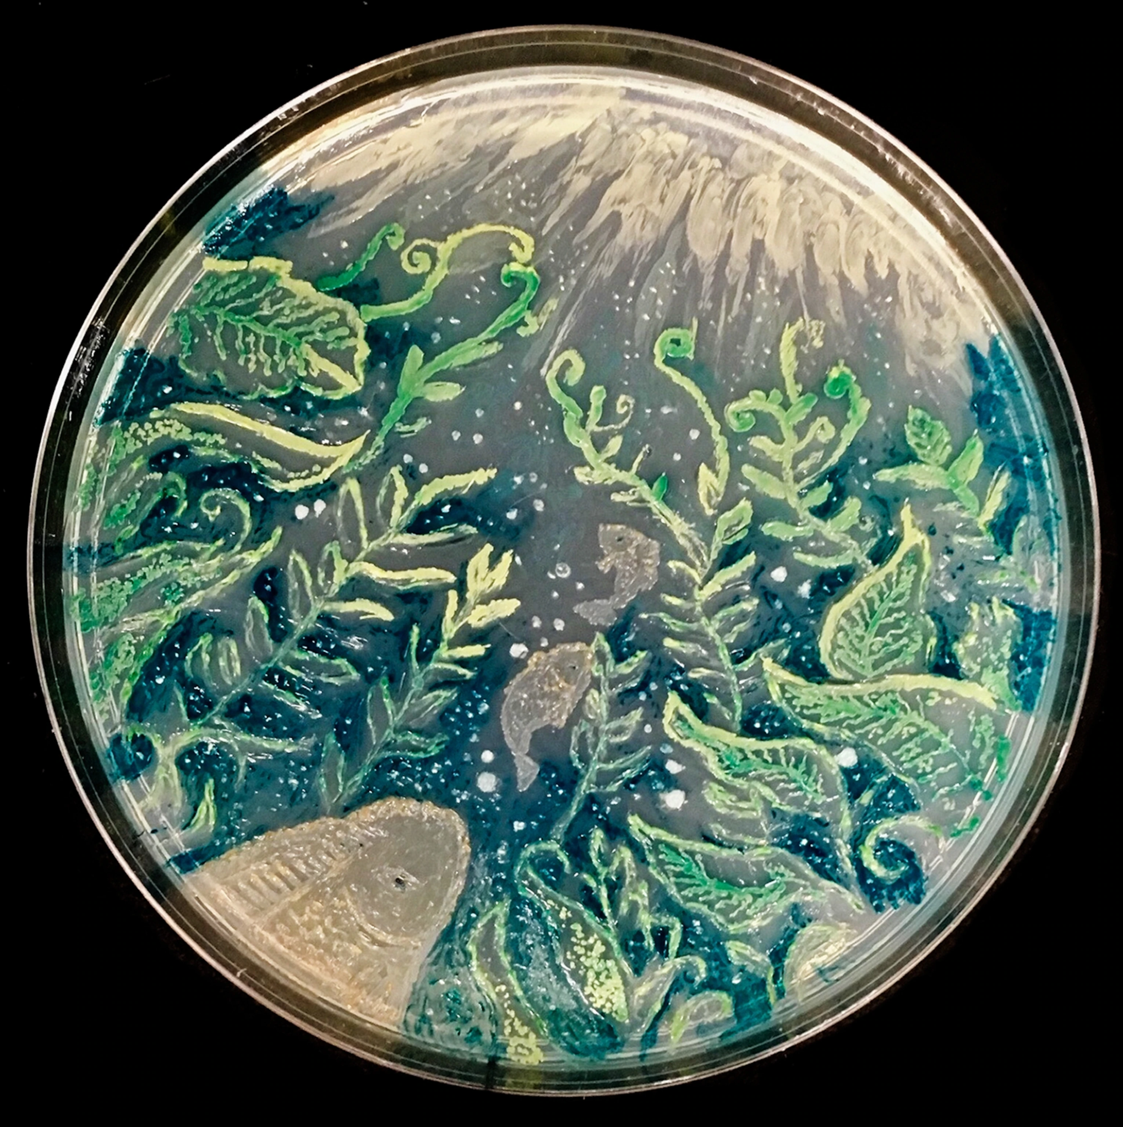



Notes:
And just for fun, a lot of scientists like to make “art” with this. Here are a few examples
Click until you get through all of them

Slide 52



Centrifuge
Notes:
A centrifuge is used to separate particles suspended in a liquid according to particle size and density, viscosity of the medium, and rotor speed. Within a solution, gravitational force will cause particles of higher density than the solvent to sink, and those less dense than the solvent to float to the top. It separates into supernatant and pellet, as you can see above.
We use this in our research to purify our bacteria.
Think of it as a washing machine on the spin cycle, but for lab work [click]

Slide 53

Autoclave
Notes:
The autoclave is super important to all research!
Autoclaves operate at high temperature and pressure in order to kill microorganisms and spores. They are used to decontaminate certain biological waste and sterilize media, instruments and lab ware.
Without it, we can’t really do any research at all.
You’ll see many different designs, but the image above describes the basic workings of it.

Slide 54
Just to wrap it all together again
Why this is important….

Slide 55



Slide 56



Slide 57



Slide 58
HOW YOU CAN GET INVOLVED!

Slide 59
We’re holding an infographic/meme competition!
Send us your best memes, artwork, or infographics related to iGEM, synthetic biology, or antibiotic resistance, and we will credit you on our iGEM wiki (if you want)!
If your work is selected for publishing, you can put on your resume that you assisted with a University of Florida iGEM team project, and put our names and wiki URL as a reference!
Top 3 winners get to contact us for advice related to UF, iGEM, science research, and get a Zoom lab tour!
Rules: unlimited submissions, anything related to this presentation, and make sure it is funny or artistic (whatever you are going for)

Slide 60

Submission Instructions
Email: ufigemteam@gmail.com
Subject line: RISE project
Send in highest resolution possible! We accept PNG, TIFF, JPG, PDF, etc.

Slide 61



Examples

Slide 62


CONCLUSIONS
@uf.igem
Antibiotic Resistance is coming! Do your part to complete your dose and listen to your doctor!!!
Science is fun! But complicated!
Keep iGEM and UF on your radar in the future!
Follow us on Instagram and don’t forget to send us your submissions!

